Slide 1

GiD v18 news
GiD Development Team:
Miguel Pasenau, Enrique Escolano, Abel Coll, Adrià Melendo, Javi Gárate, Laura Santos

Slide 2
GiD 18 news - Outline
Main news in pre-processing
Main news in post-processing
Main news in visualization
Main news in Customization
Main general news
Future lines

Slide 3
GiD 18 news - Outline
Main news in pre-processing
Main news in post-processing
Main news in visualization
Main news in Customization
Main general news
Future lines

Slide 4
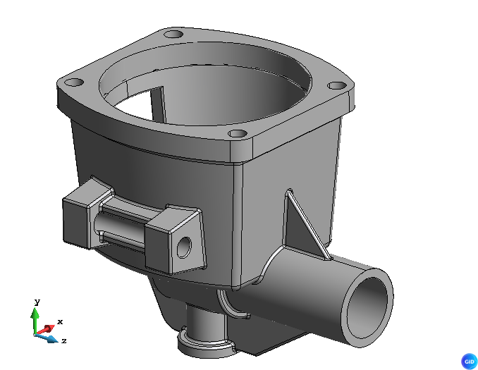
OpenCASCADE BREP CAD format import.
BREP format used for example by FreeCAD. Open the door to OpenCASCADE to be used as CAD Kernel.
Notes:
OpenCASCADE is the main open source CAD library.
This is our first step in GiD to include OpenCASCADE features: start importing its native CAD format, that follow the same topology of GiD
OpenCASCADE is important because it provides GiD with a powerful CAD kernel for B-Rep geometry, Boolean operations, CAD import/repair, and advanced geometric modeling capabilities, enabling more complex and robust preprocessing workflows.

Slide 5
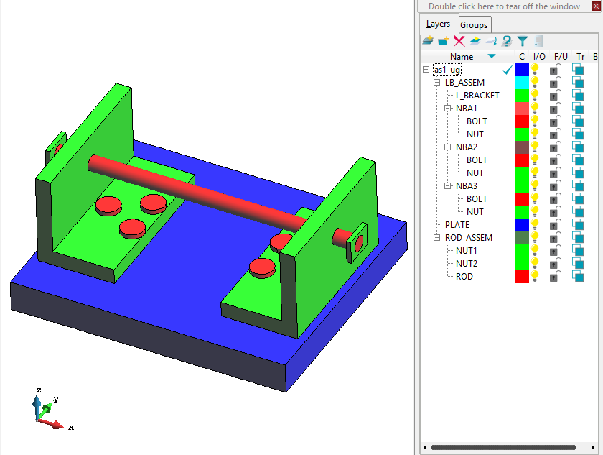
STEP import using OpenCASCADE reader
STEP is the most important CAD exchange format
OpenCASCADE provide the ability to parse assemblies
and also IGES import using OpenCascade reader, but our legacy reader is similar.
Notes:
The next natural use of OpenCASCADE after reading its native BREP format is to leverage its exchange capabilities for the STEP format.
Our legacy reader, based on the StepCode library, sometimes has problems properly traversing the model in the case of assemblies
(i.e., creating instances by applying multiple transformation matrices).

Slide 6
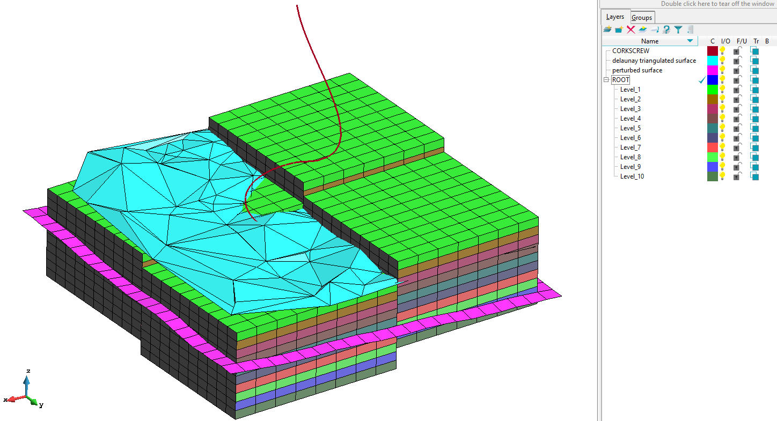
RESQML™ mesh import (GiD Tcl-Python plugin)
Standard format from ENERGISTICS™ used for earth description for oil and gas uses
Notes:
GiD Tcl-Python plugin to import some mesh formats related to oil and gas sector
Earth vision grid files (ASCII files with NxM grids in 3D, or Z raster grids)
Import neutral format .nf with hexahedra mesh
Import RESQML format .epc + .h5 mesh, and importing in post convert also properties to results
- IJKGrid -> hexahedra
- Grid2d -> quadrilaterals
- Unstructured grids -> tetrahedra, hexahedra or prisms
- Triangulated sets -> triangles
- Wellbore_trajectory -> lines
- Properties -> results on elements

Slide 7
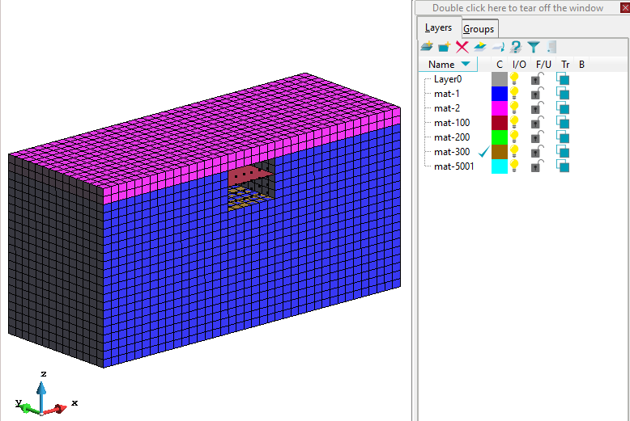
OpenSees mesh import
New plugin to import OpenSees mesh (and some other data if problemtype OpenSees was loaded)
Note: OpenSees is an open-source software framework for simulating the seismic response of structural and geotechnical systems using finite element methods.
Notes:
GiD plugin to read .tcl OpenSees mesh files
and if problemtype is loaded maps some data into GiD-OpenSees problemtype data (general data, intervale data, conditions: Point_Restraints
, Point_ZeroLength, Point_Equal_constraint_master_node/Point_Equal_constraint_slave_nodes,…)

Slide 8
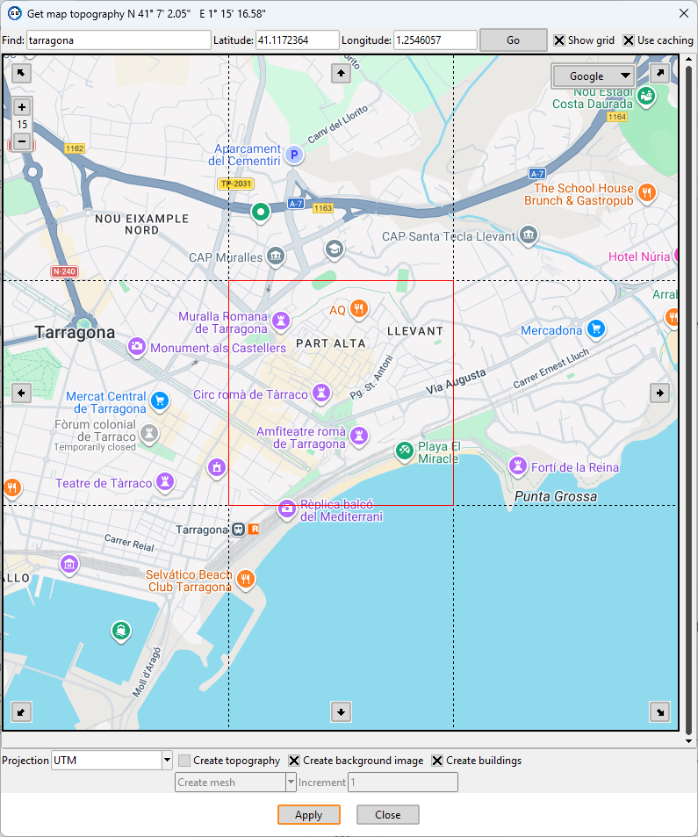
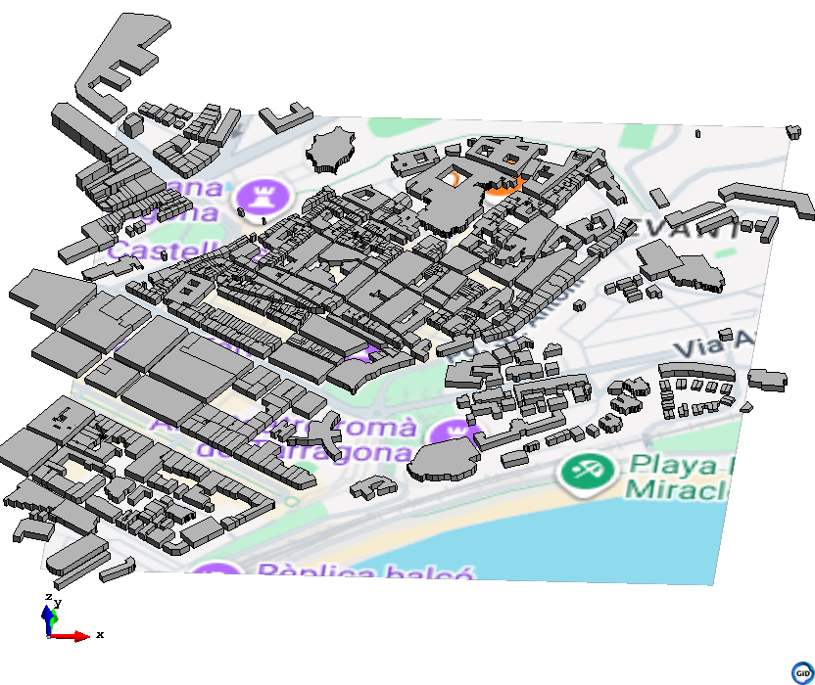
Import topography create buildings feature
Added a new feature to the “topography” plugin to extract polygon data from OpenStreetMap and generate geometric volumes.
Notes:
OpenStreetMap is a free, collaborative map database that provides geographic data such as roads, buildings, and points of interest.
You can extract information like street networks, locations, and spatial features of cities and landscapes.

Slide 9
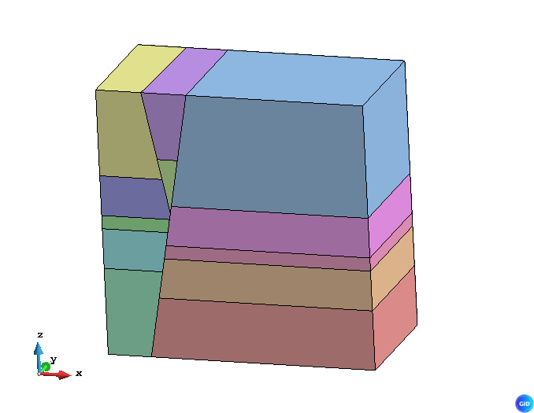
Create volumes search all
New tool to try to automatically find all possible closed volumes
And enhanced create surface search and volume search
Example of a 3D terrain model with a fault across stratified layers
Notes:
Recursive algorithm to try to create automatically missing volumes, from existing connected surfaces, with some heuristic driving rules

Slide 10
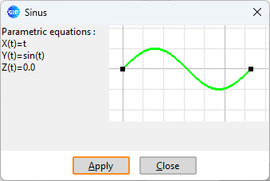
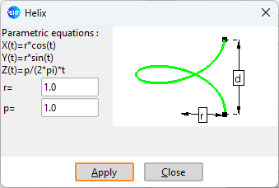
Create parametric lines
Window enhanced facilitating examples (sin, helix)
Fill in some common parametric curve formulas that are both usable and serve as examples.

Slide 11
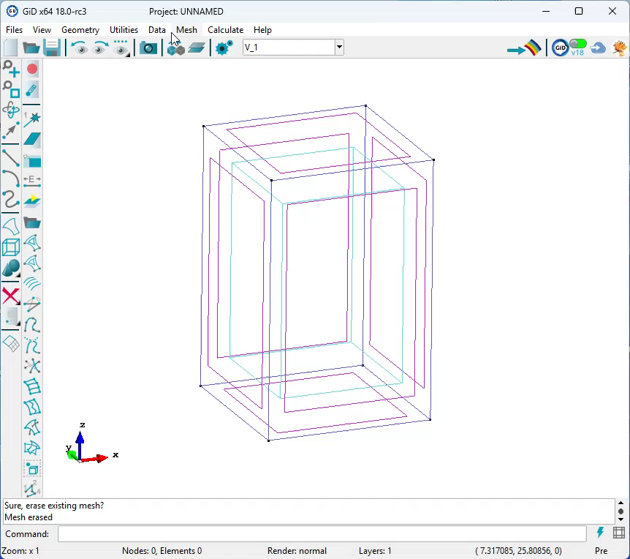
Preview line mesh
Mesh->Preview line mesh.
To interactively test mesh sizes and see the line nodes

Slide 12
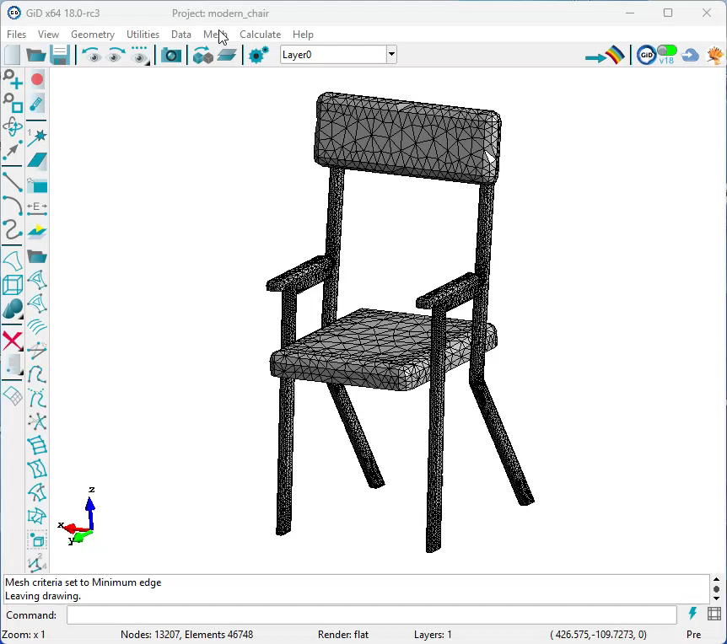
Draw mesh quality of elements with color

Slide 13
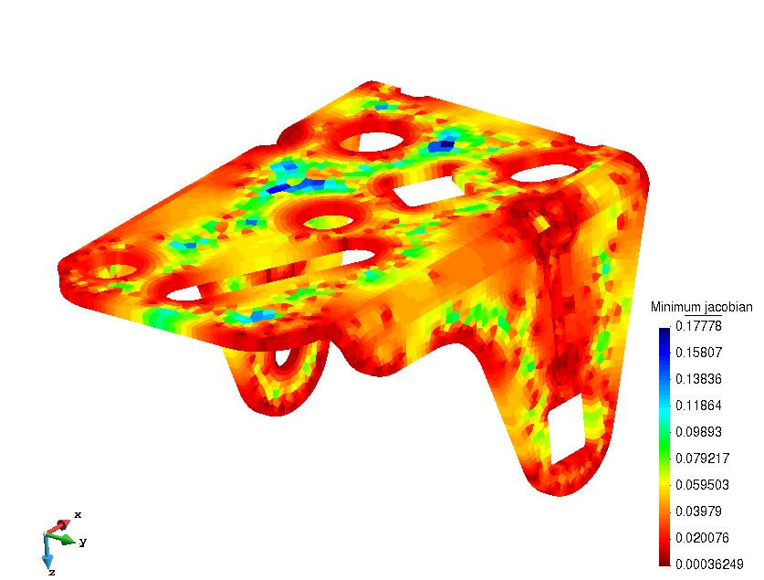
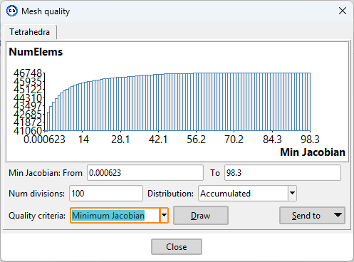
Draw mesh quality of elements with color

Slide 14
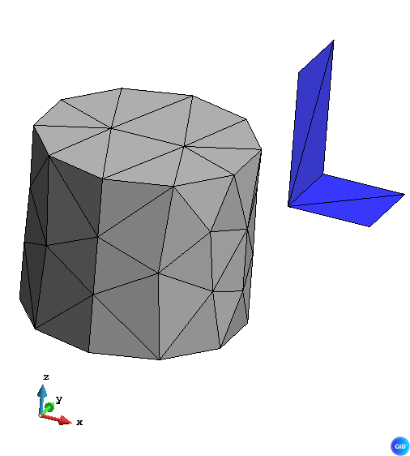
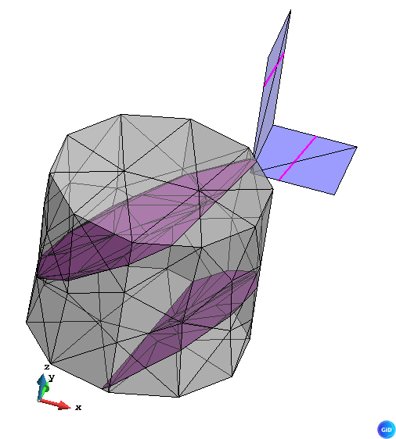
Cut preprocess mesh
Edit mesh->Cut plane
  Cut volume and surface elements of any type.
  Sort intersected elements into consecutively connected regions.
  Ensure consistent normal orientation across neighboring elements.
Notes:
Useful for reconstructing geometry from large triangulations by generating a network of nearly orthogonal cross-sections, converting connected segments into curves, and creating surfaces between them (e.g., topography or organic biomedical shapes obtained from scans).
Implemented for all type of volume elements (tetrahedra, hexahedra, prism, pyramid) and surface elements (triangle, quadrilateral)

Slide 15
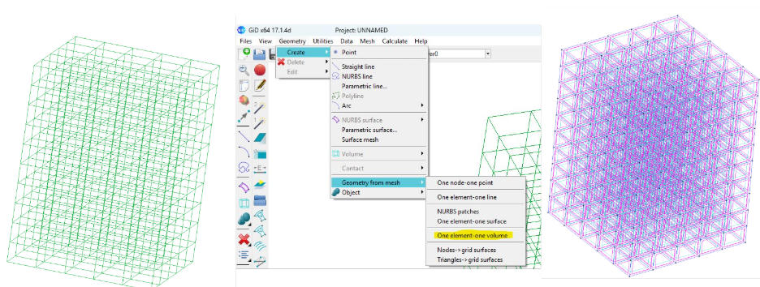
Create geometry from volume mesh elements
Reconstruct geometry when only mesh is available
Notes:
e.g. to re-calculate a model of other software
After convert to volumes they can be joined, and then can be joined surfaces, and then curves, to have few entities and facilitate edition, assign data, and re-meshing

Slide 16
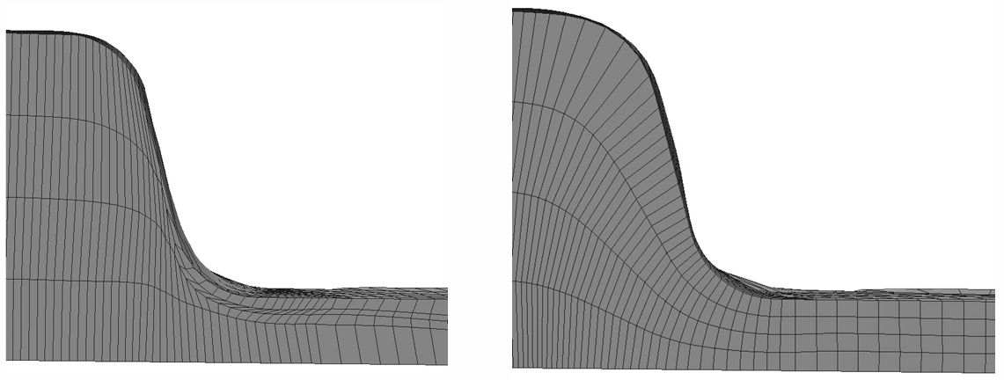
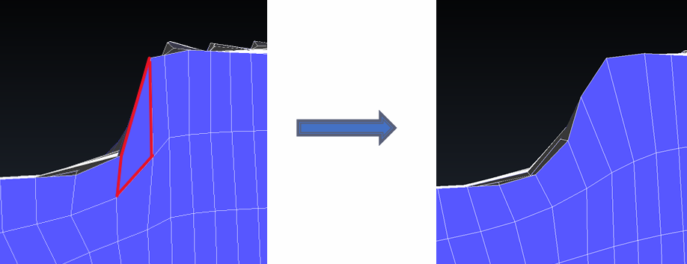
Hexahedra smoother enhanced
The hexahedra smoother (based on the minimization of the distortion of the elements) has been improved in terms of quality and performance. Development in collaboration with Stampack company. Available from GiD, and using GiDML library.

Slide 17
Other preprocess features
Insert GiD project now also import the classic problemtype data (conditions and materials)
New tool intersection volume-surfaces
Join volumes, allow multiple creation.
Join surfaces option to join also its curves
Join lines allow join also if have structured number divisions
Move Lines z raster (to set z coordinates of curves from a raster image)
Refactor Copy/Move window
New feature to collapse 3D points considered in 2D projection (to import xyz cloud of points of terrain and connect with triangles by Delaunay)
Parasolid import updated to 36001 version
DetachMeshFromGeometry added to preferences window
Mesh generation performance improved

Slide 18
GiD 18 news - Outline
Main news in pre-processing
Main news in post-processing
Main news in visualization
Main news in Customization
Main general news
Future lines

Slide 19
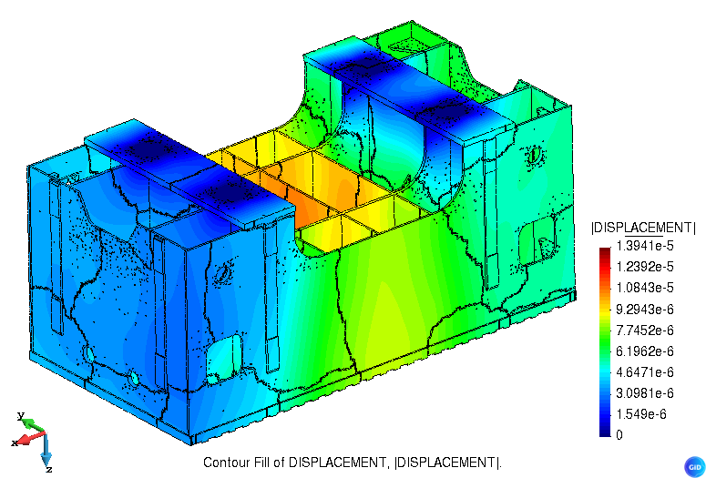
VTK format import and export of mesh and results
Rewritten from scripting to native C++, and updated to VTK 9.3 version (windows) and VTK 9.6 (Linux and macOS).
Notes:
VTK drop Tcl wrapper support since 8.1.2
Now GiD directly use VTK library at C++ level, increasing performance of import/export of mesh and results and allow modern versions.
Open the door to use more VTK algorithms

Slide 20
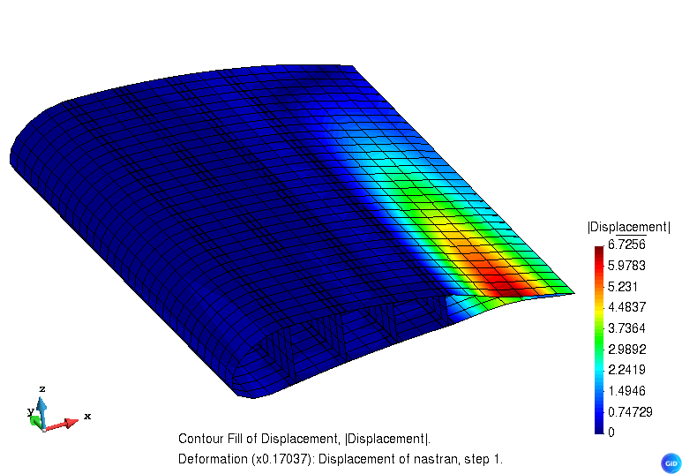
NASTRAN results op2 format import
Files->Import->PyNastran…
New plugin to import NASTRAN mesh in .bdf format with results in .op2 format (using the PyNastran Python library)
Notes:
Planned NASTRAN results export feature. Implementation is bounded by the format's limitation to predefined data blocks instead of generic fields.

Slide 21
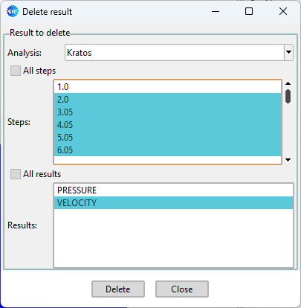
Delete result window
E.g. to share part of the results, saving disk and memory space
Notes:
Facilitate crate smaller testing cases

Slide 22
Other postprocess features
Reducing memory and CPU time if many threads are used, reading big meshes, holes in nodes numbering, orphan nodes, …
Faster updates of Display Style Windows when using big meshes.
Create result window enhanced
RESQML™ mesh import and also properties as results

Slide 23
GiD 18 news - Outline
Main news in pre-processing
Main news in post-processing
Main news in visualization
Main news in Customization
Main general news
Future lines

Slide 24
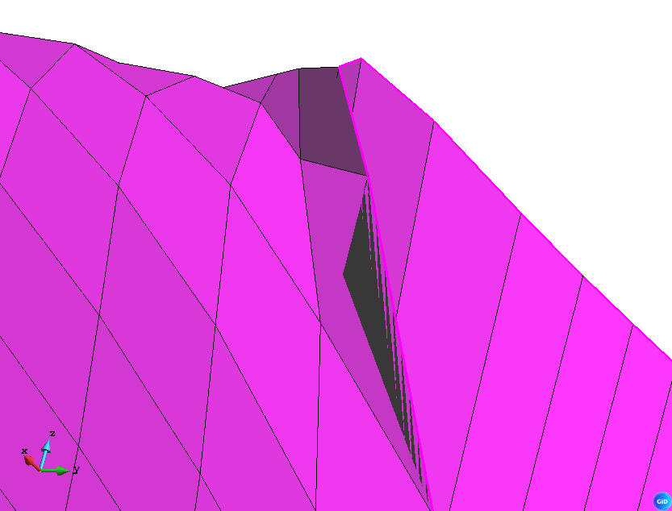
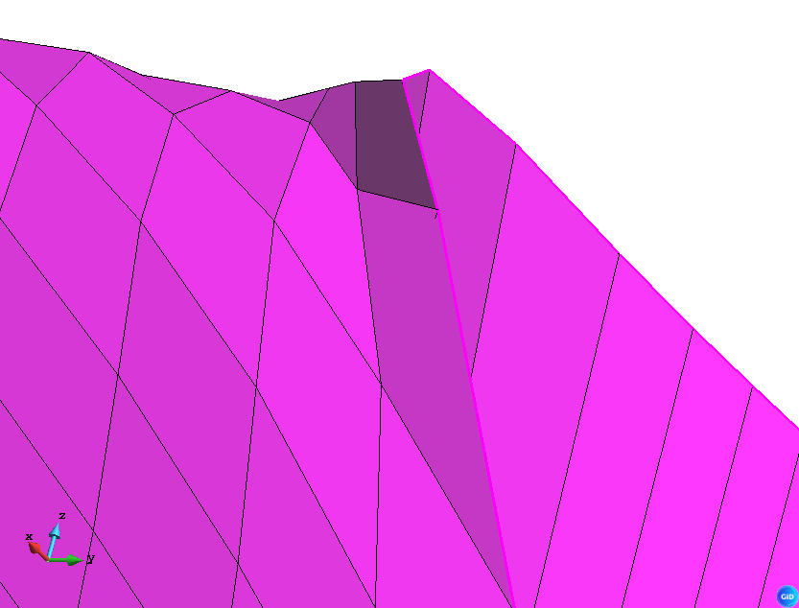
Improved rendering of quadrilateral / hexahedral meshes
In Pre- Drawn as 4 triangles instead of OpenGL's default 2 triangles for NVidia cards or MS generic driver, same as in Post-. On some deformed hexahedra, drawing quads as 2 triangles showed some visualization errors.

Slide 25
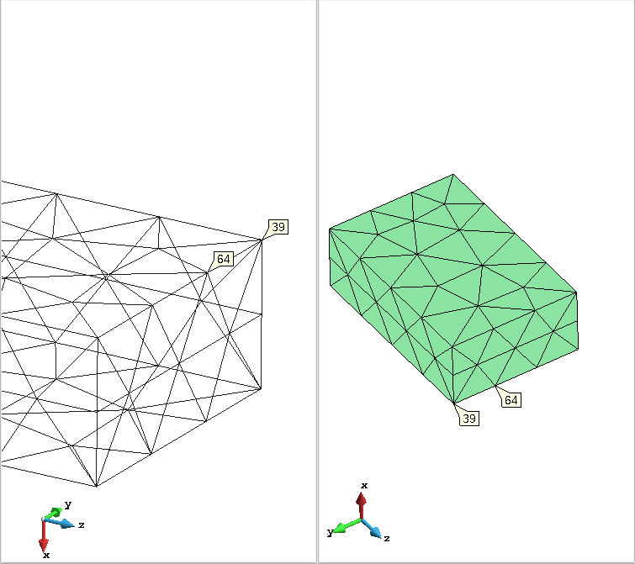
Multiple views allow different style by view
E.g. a view show ‘all lines’ and other view ‘body lines’
Notes:
Unfortunately nowadays each view cannot have its own result. It is a desired feature for the future, if feasible.

Slide 26
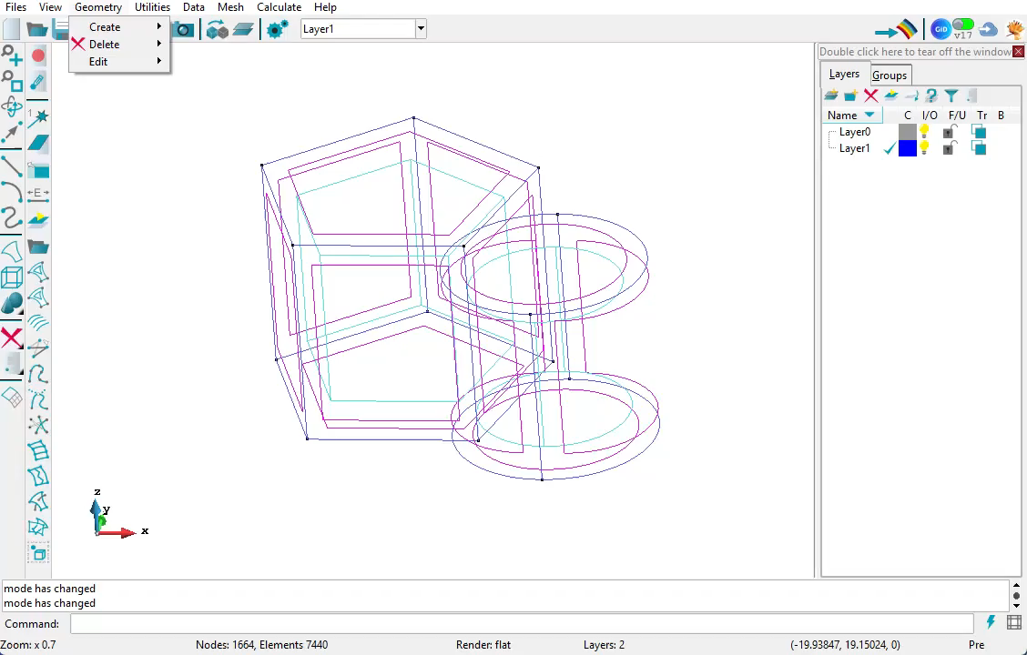
Multiple views allow ‘link views’
Notes:
To move all views simultaneously

Slide 27
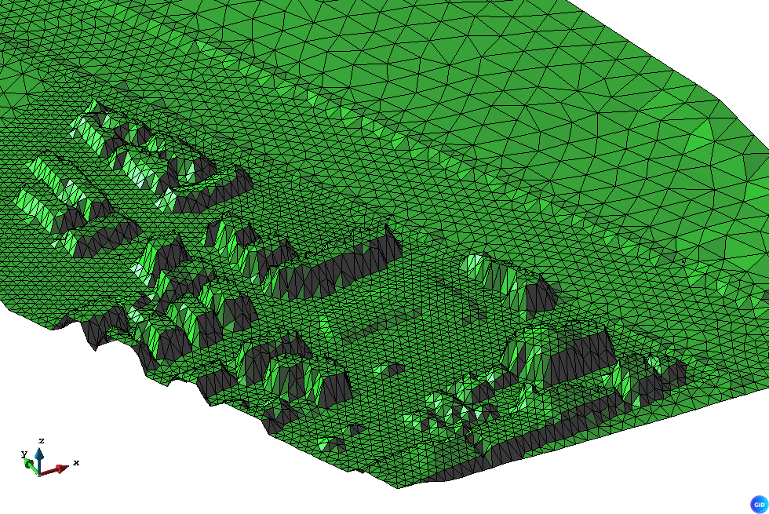
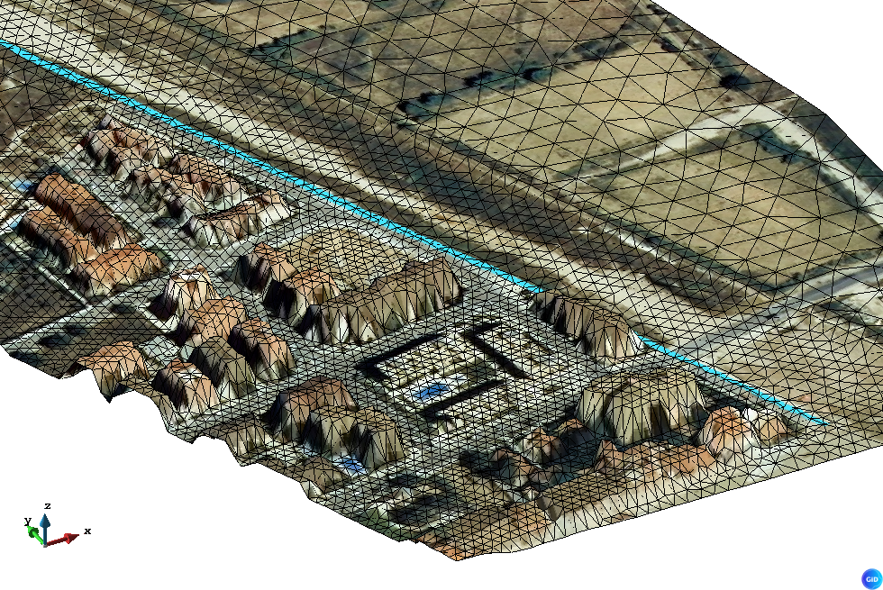
Draw terrain images as 3D
View->Background image->Create projected on mesh

Slide 28
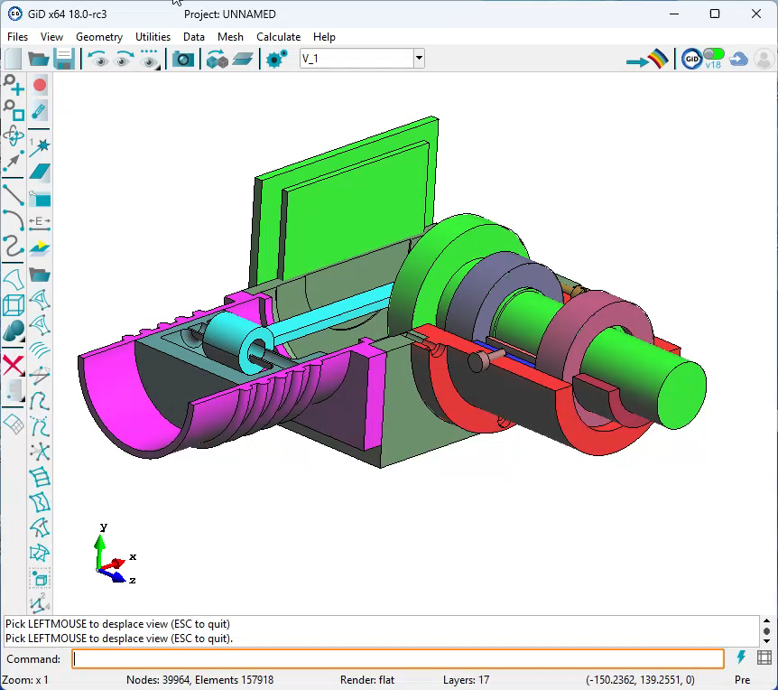
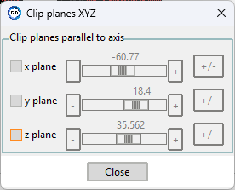
Clip planes parallel to X, Y or Z
3 optional clip planes
Swap visible side

Slide 29
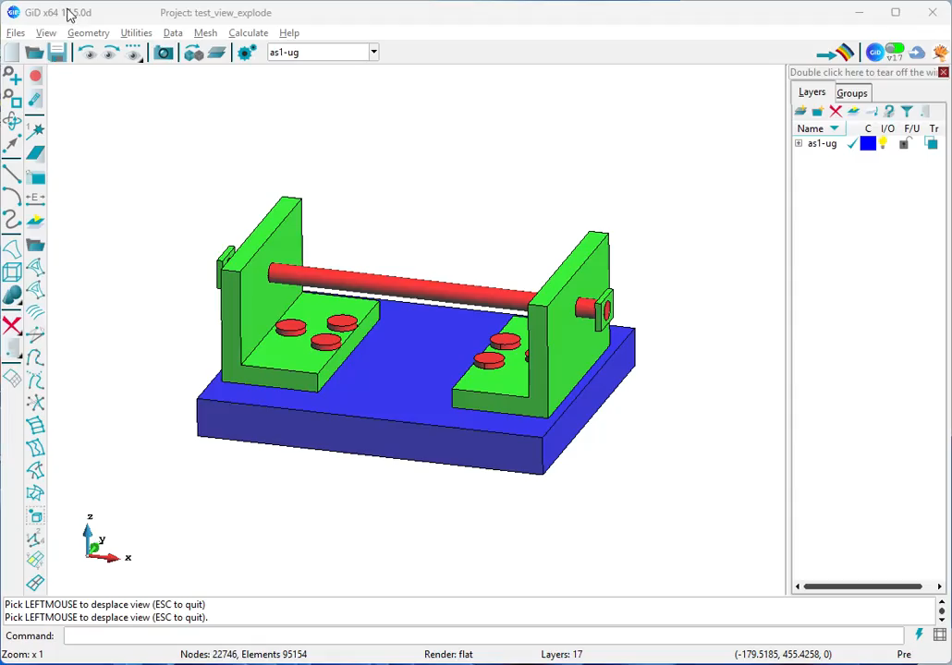
Explode view
To highlight unconnected parts
Notes:
In geometry view depends on the current topology of connected parts
In mesh view calculate connected parts of elements to be drawn exploded

Slide 30
GiD 18 news - Outline
Main news in pre-processing
Main news in post-processing
Main news in visualization
Main news in Customization
Main general news
Future lines

Slide 31
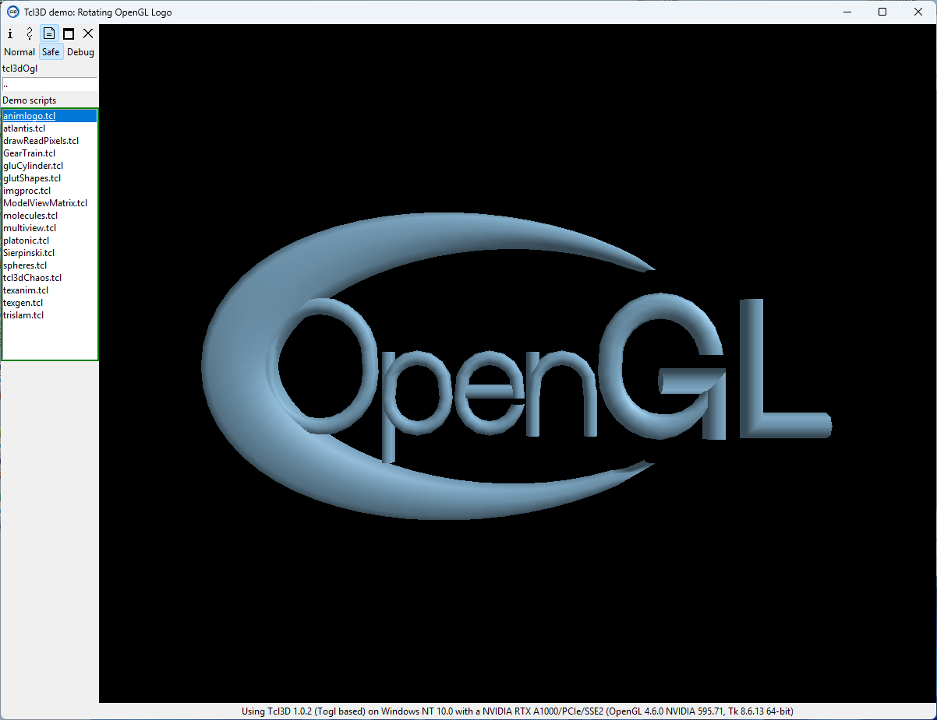
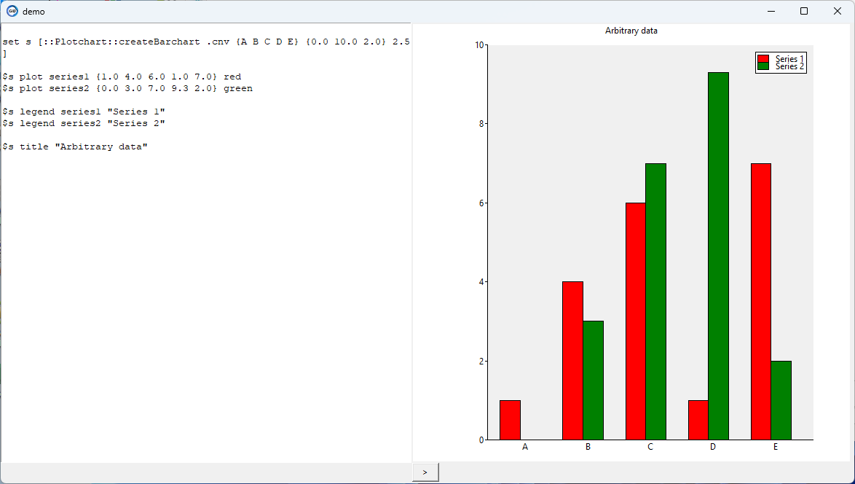
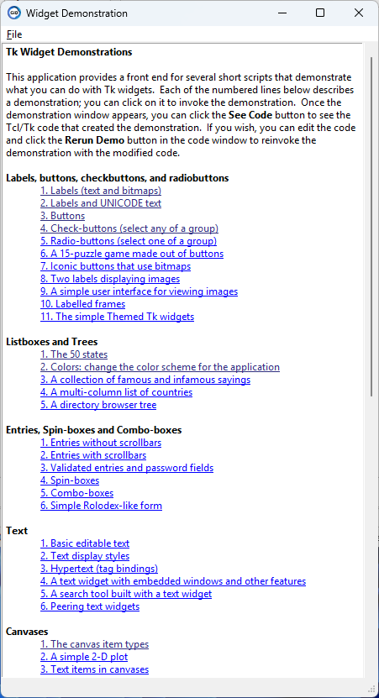
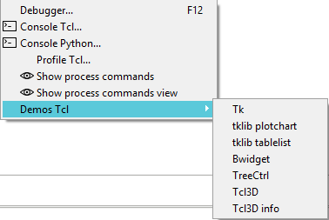
Facilitate Demos Tcl
Menu: Utilities->Tools->Developer
Notes:
To discover and quickly experiment with Tcl code demonstrations.
Tcl3D allows developers to evaluate OpenGL shader programming capabilities within a Tcl scripting environment.

Slide 32
Programming:
Windows and Linux register gid:// URL protocol handler.
python.bat / python launch scripts in main GiD folder to be more visible.
GiD and all packages ready to a future replacement of Tcl 8.6 by Tcl 9
Preliminary version of a VS Code extension to debug Tcl based on ramdebugger (<gid>\scripts\ramdebugger\vscode-tcl-debug\tcl-ramdebugger-0.1.0.vsix)
Platforms supported: MS Windows 64, Linux Intel x64, Linux arm64, macOS Intel x64 and macOS Apple Silicon (arm64).

Slide 33
Programming: GiD Tcl commands
  GiD_GetFlag <flag> Tcl command to get some start flags
  GiD_Project db save background_image <filename>
  GiD_Project set disable_draw_set ?<0|1>? to draw or not the model and draw a custom version.
  GiD_Layers get bounding_box <layer_name> geometry|mesh
  GiD_Geometry get point|line|surface|volume <id> label_position|layer , and GiD_Mesh get node|element <id> label_position
  GiD_Raster create {from_raster_cells_to_nodes <raster>} to create a new raster_nodes averaging cell values
  GiD_Tools mesh slice <A B C D> ?<element_ids>?
  GiD_Tools mesh classify_node_connected_parts | elements_mean_center elements_bounding_box ?<element_ids>?
  GiD_Sets get bounding_box <set_name>
  GiD_Sets edit, delete, list, window, exists subcommands:
  GiD_Result list subcommand
  GiD_Info mesh -post and GiD_Result get_nodes with extra flag -deformed
  GiD_Info mesh -post HasRepeatedElementId
  GiD_MeshPost edit renumber elements consecutive

Slide 34
Programming: GiD Tcl events
Packages
  Tcl package gid_bounding_box
  objarray package v 1.19 new command objarray extract
  objarray_numpy pure python package to facilitate transfer arrays between Tcl and numpy.
  tcl3d 1.0.2 basic packages (OpenGL wrapper)
  Updated all Tcl related packages to latest versions.
Problemtype related
  Classic problemtype predefined TKWIDGET: GidUtils::TkwidgetButton
  CustomLib tree allow use .svg vectorial images, and scale them with better quality
  New optional <problemtype>.ini , used with flags -p and -c2 to use it as alternative to scripts/gidDefaults
Events
  GiD_Event_AfterSetDisplayStyle and GiD_Event_AfterSetResultsView
  GiD_Event_BeforeDrawModel to allow more GiD_OpenGL control

Slide 35
GiD 18 news - Outline
Main news in pre-processing
Main news in post-processing
Main news in visualization
Main news in Customization
Main general news
Future lines

Slide 36

Internal changes
Use internally vcpkg on Windows (C++ package manager) to handle third part libraries, and a lot of them have been updated to latest versions.
Linux + latest NVidia drivers : improved starting time of GiD.
Internal replacement of vector and matrix objects by eigen3 library.
Run simulation: command.exe is not required now to start the process.

Slide 37
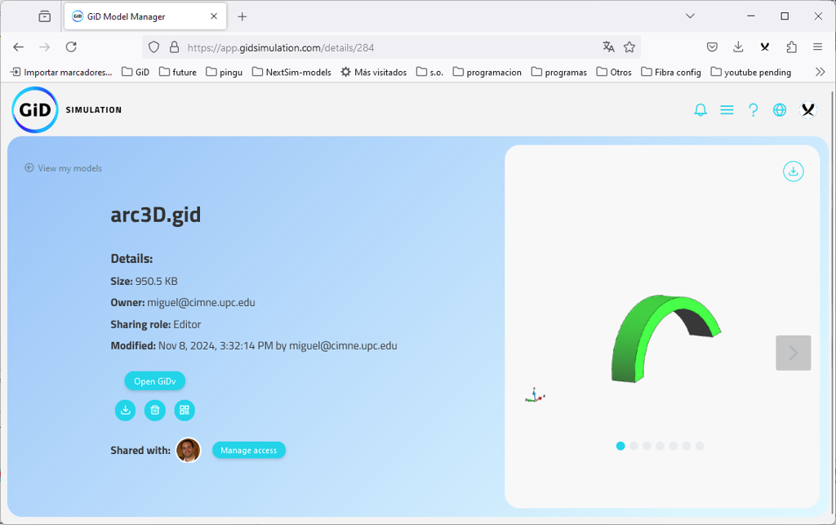
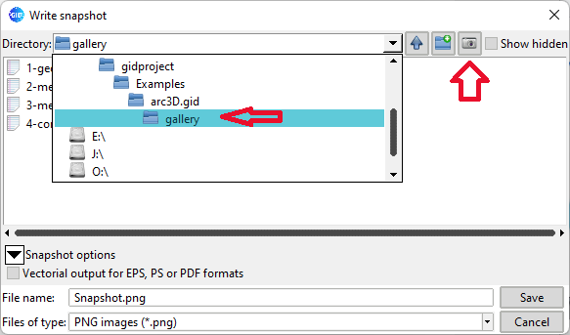
Gallery snapshot folder
Option in Snapshot/animation save file dialog to save files in project.gid/gallery/ folder which is accessible from the Model Manager as Gallery

Slide 38
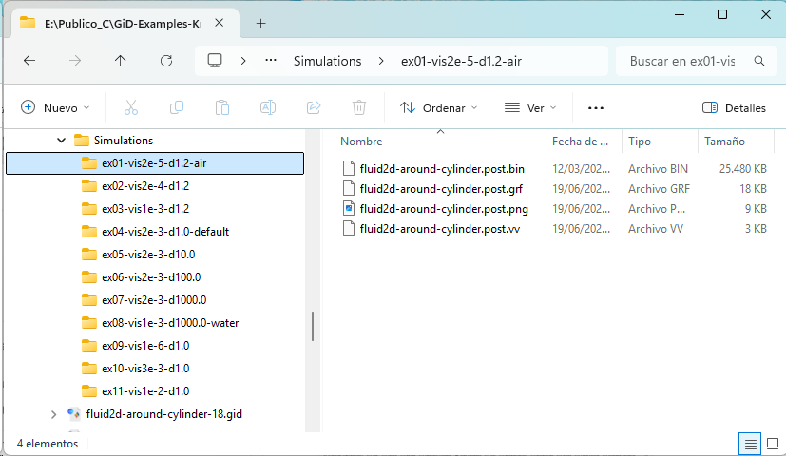
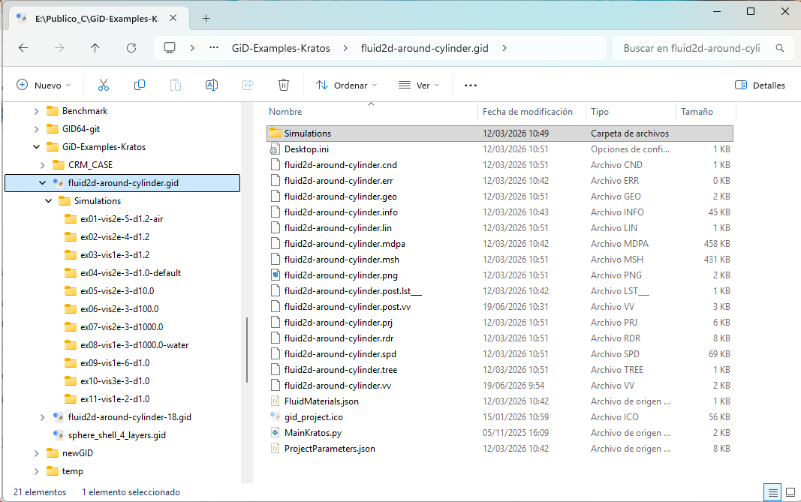
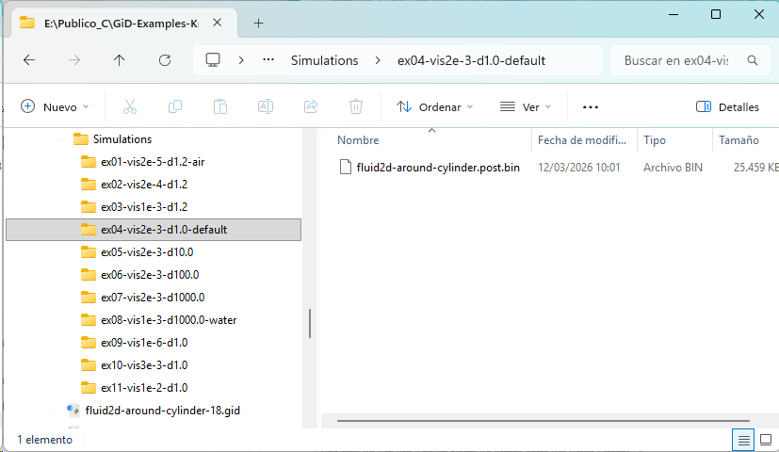
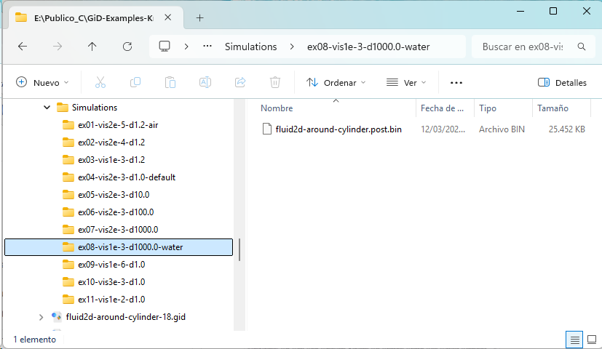
Preview : several Simulations results with same geometry
Several results inside ‘Project.gid/Simulations’ folder:
GID 18 news – main general news

Slide 39
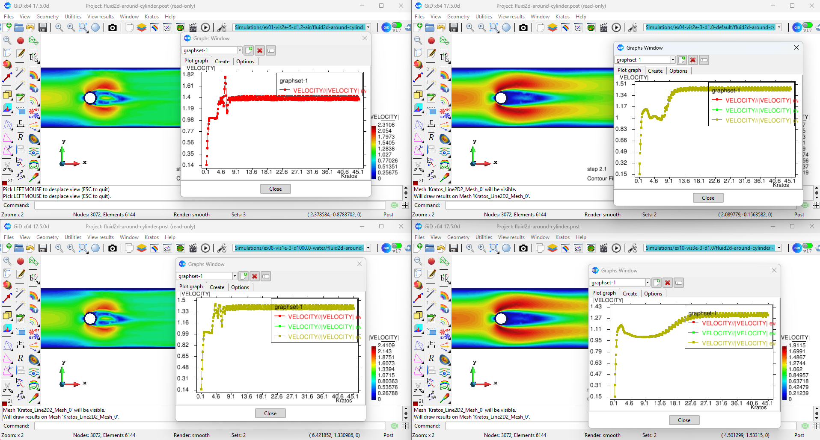
Preview: several simulation results
Notes:
To handle results of multiple simulations of the same model, stored in the Simulation folder. The combobox allow to read each one

Slide 40
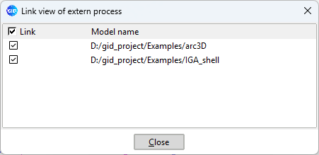
Link external process
View → View → Link external process…
To link with other running GiD process and move them from this master GiD, to visually compare models:
Notes:
GiD automatically detect an connect with other GiDs running in the same machine.
This allow to open two different models to be visually compared, synchronizing its view (the master process control the rest of slaves)
Could be the same model and show a different result in each GiD
(this cannot be done with multiple views of a single GiD, because all views share the same current result)

Slide 41
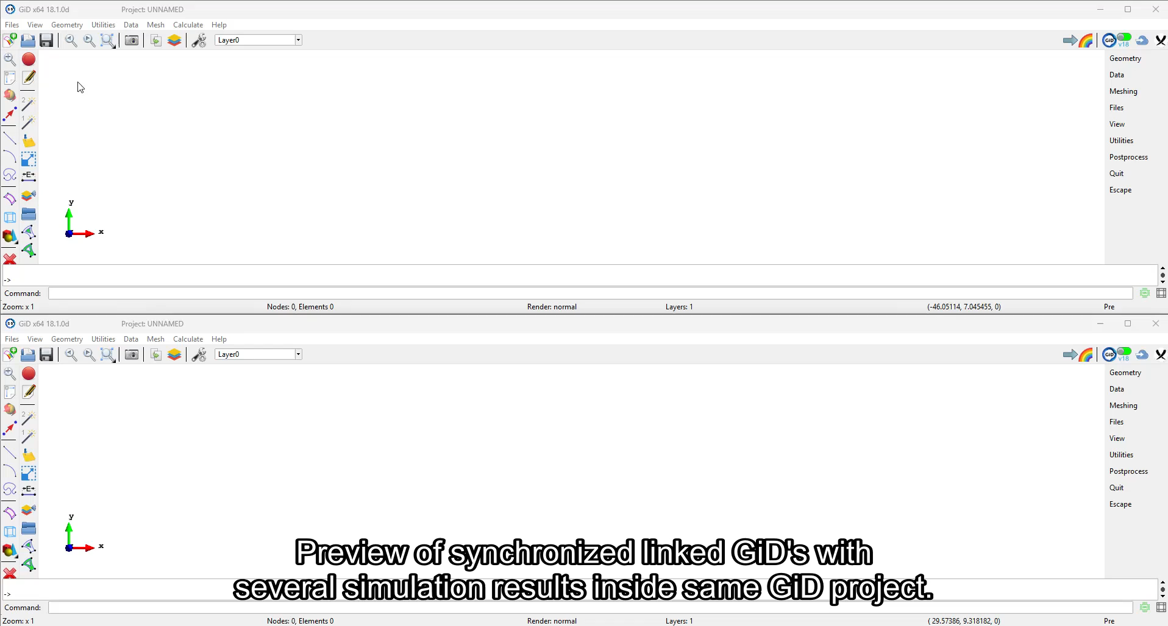
Preview: linked GiDs and several Simulation results
GID 18 news – main general news
Notes:
Link external process, example of use to show synchronized results of two different models

Slide 42
GiD 18 news - Outline
Main news in pre-processing
Main news in post-processing
Main news in visualization
Main news in Customization
Main general news
Future lines

Slide 43
Future lines…
More geometry features related to OpenCascade library
  Create render mesh of surfaces
  Boolean operations, round edges,…
  Maybe wrap its drawexe commands as Tcl package
More mesh and results visualization features related to VTK library
Use GPU generic calculation through Vulkan (multiplatform) for some operations
GiD as (MCP) tool for IA agents
Use assimp C++ library to read more render mesh formats
Length units in GiD model, dropping load problem-type requirement
Lots of internal code refactoring.
Postprocess linked-gids: synchronize result visualization across several GiDs.
Postprocess support for several simulations inside the same project.
Legend refactoring. Reflection (zebra-effect per set/layer) window re-lifting.
Add support for ZFP compression.

Slide 44
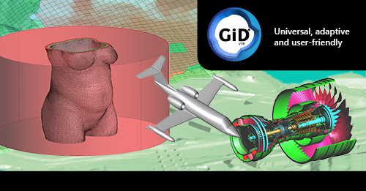
Thanks for your attention

