Slide 1
GiD Simulation Platform news
GiD Development Team:
Miguel Pasenau, Enrique Escolano, Abel Coll, Adrià Melendo, Javi Gárate, Laura Santos
July 1st 2026

Slide 2
GiD Simulation Platform Cloud Services
Today we will cover:
  Which features were made public in June 2024 (GiD Convention)
  Which features have we added
  Which features are we planning to add
Notes:
We are going to see a fast view on what we presented 2 years ago, and then see the new capabilities of the platform, and the future lines, so you can comment on those that can be more interesting for you

Slide 3
Previously on GiD Convention 2024
Licence Manager
Model Manager
Store models from local GiD
Share models
Online model view
  Geometry
  Mesh
  Post (contour fill)
Model size limits
GiD accounts - GiD Shop connection
Named User licences
  GiD v15, v16, v17
  GiD Subscriptions
  GiD Storage
  Problemtype licences

Slide 4
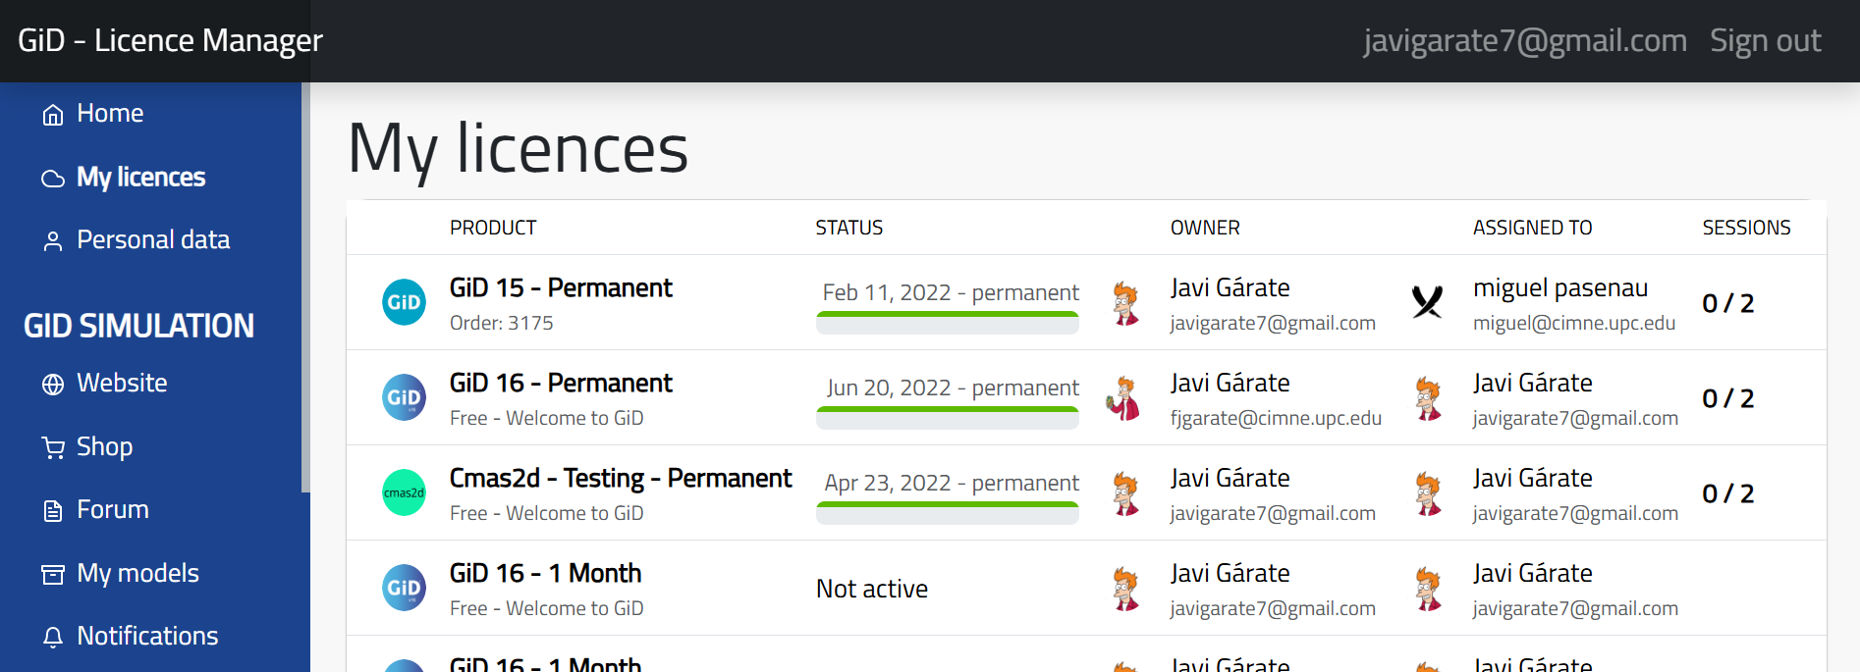
GiD Licence Manager

Slide 5
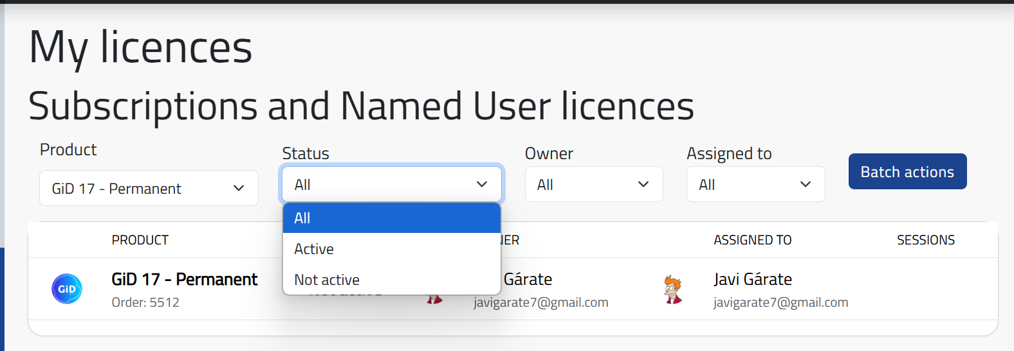
GiD Licence Manager
We added filters for users who manage many licences
  Teachers, resellers…

Slide 6
GiD Licence Manager
We imported the full licence history since 1998
We brought all licence management together
  Local, USB, Floating, free monthly licences
  Licence + (Sysinfo + Machinename +...) = Password
  Transfer licences
Batch actions
  Transfer license group (students…)

Slide 7
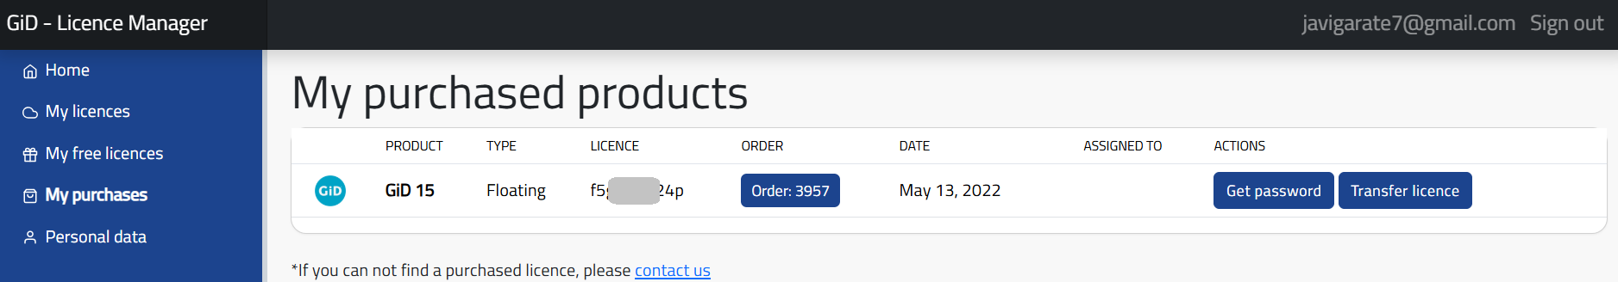
GiD Licence Manager
My Purchases

Slide 8
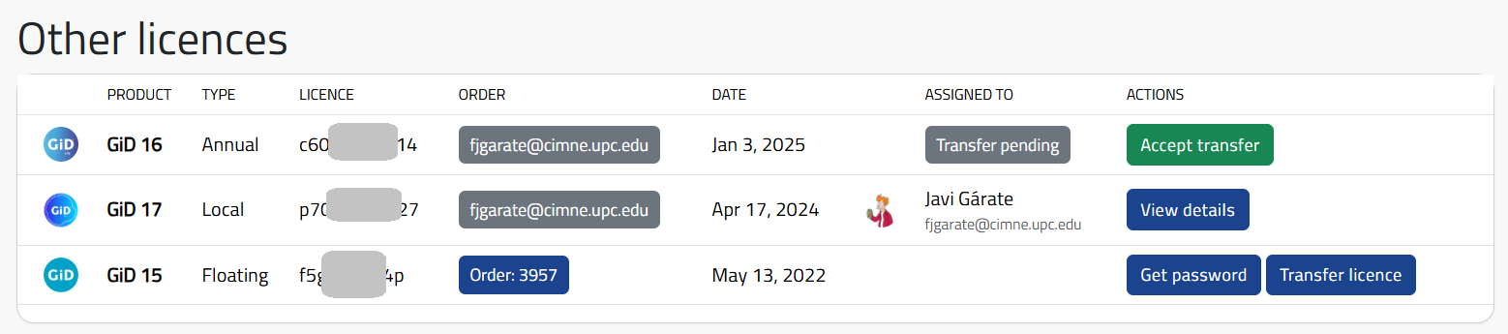
GiD Licence Manager
My Licences

Slide 9
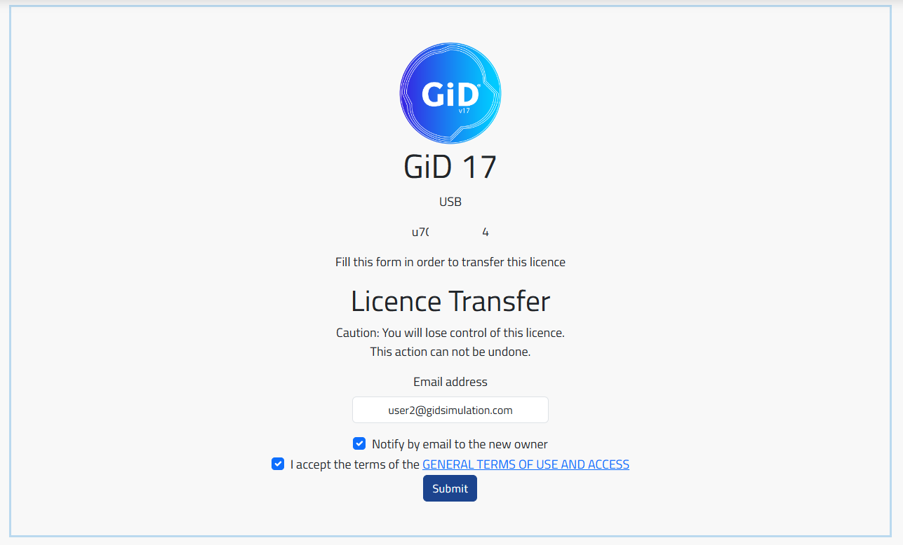
GiD Licence Manager
Transfer a licence

Slide 10
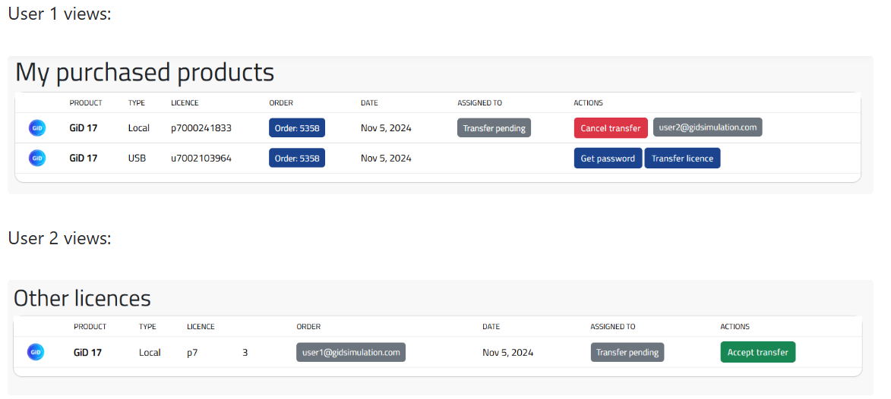
GiD Licence Manager
Transfer a licence

Slide 11
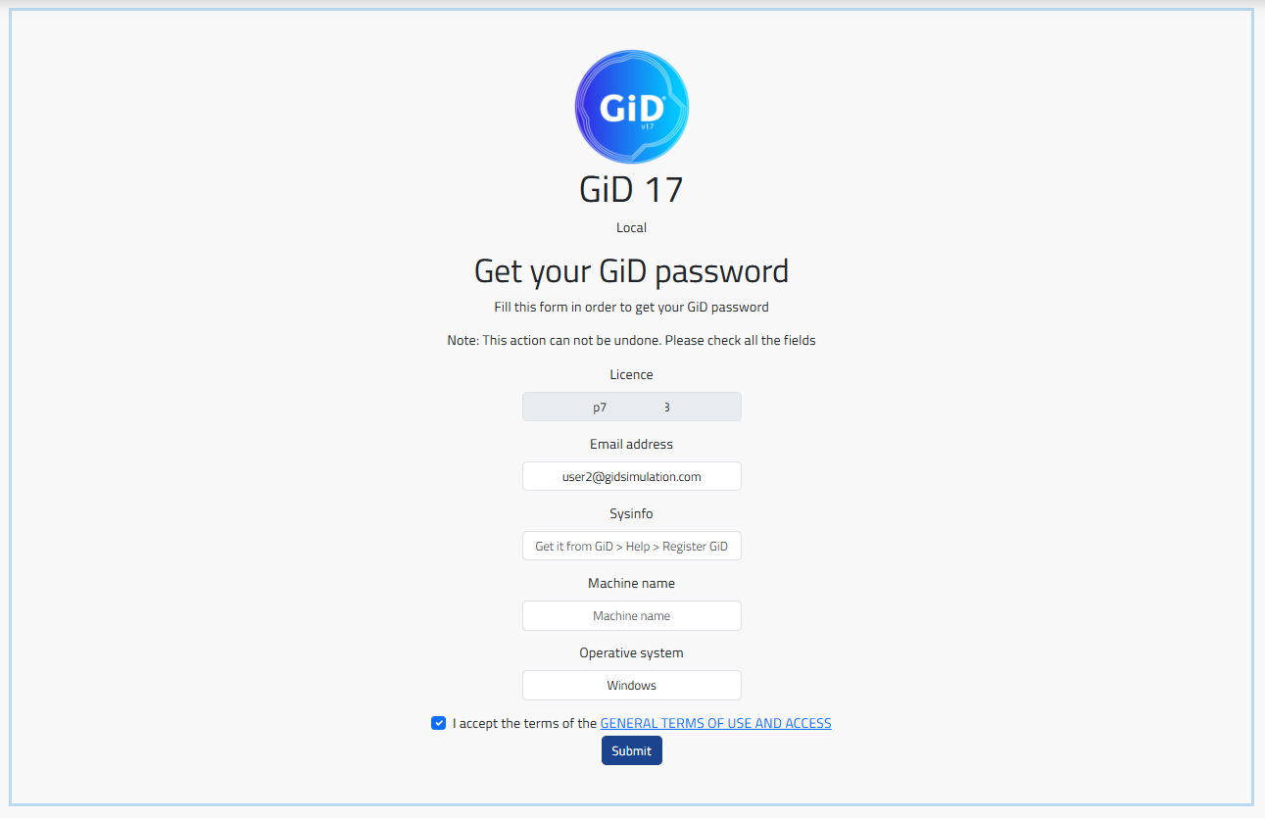
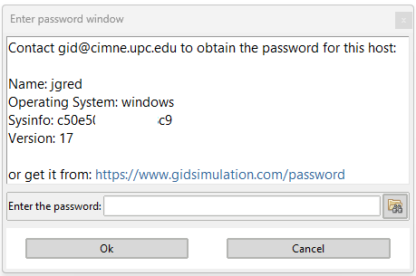
GiD Licence Manager
From licence to password

Slide 12
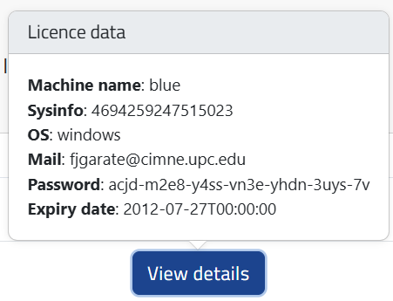
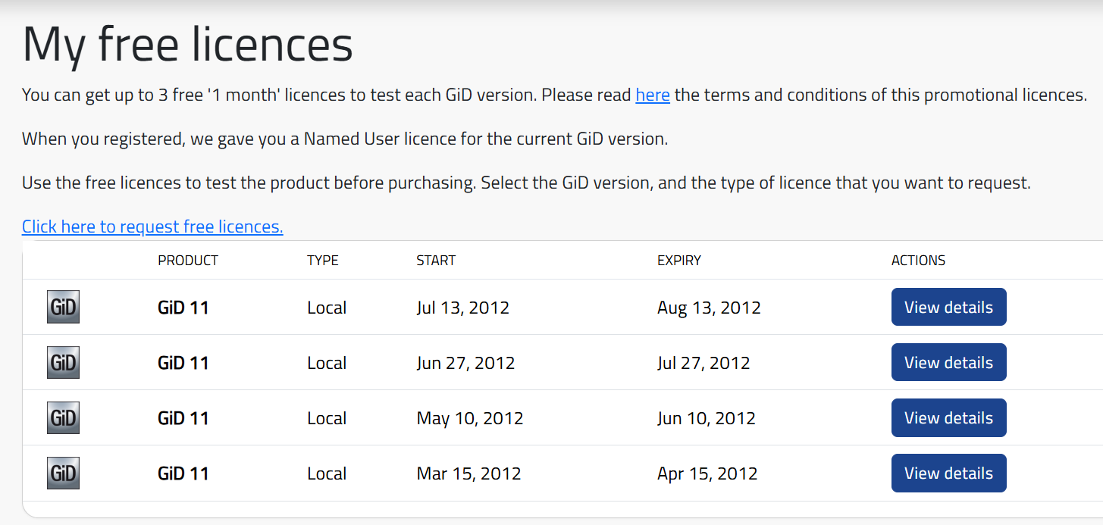
GiD Licence Manager
Free licences (monthly)

Slide 13
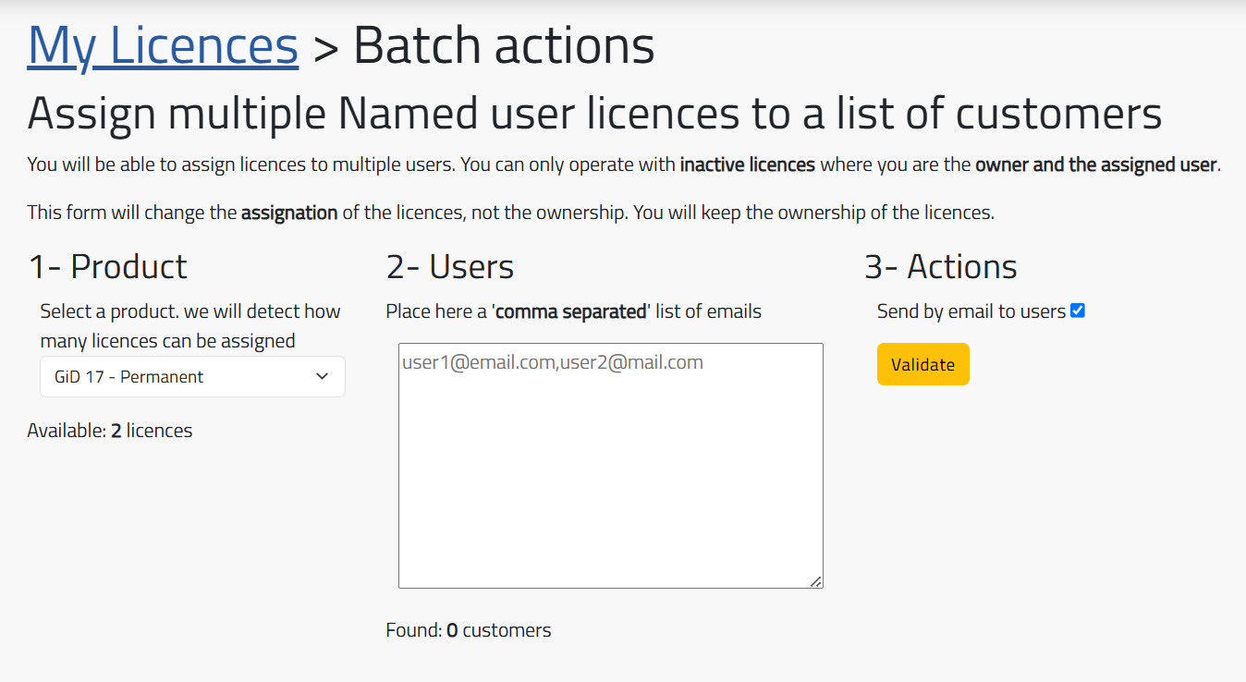
GiD Licence Manager
Batch actions

Slide 14
GiD Model Manager
Model Manager
GiD Convention 2024
Easy share
  Recommended users
  Message when sharing
Model favorite list
Open models
  from GiD Local to Web
  from Web to GiD Local
Gallery ( screenshots, clips )
More post-processing features
  Deformed shapes
  Vectors results
Offline access to models on web
Download versions of a model (zip)
Install as web app (desktop and Mobile)
Store models in the cloud from GiD Local
Share models between users
Web model visualization
  Geometry
  Mesh
  Post (contour fill)
Model size limitation
Notes:
Punto de partida → funcionalidades GiD Convention 2024
Novedades

Slide 15
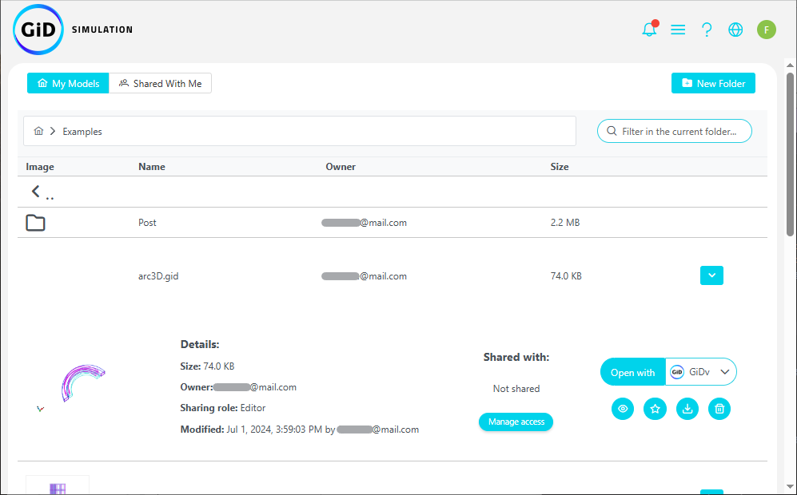
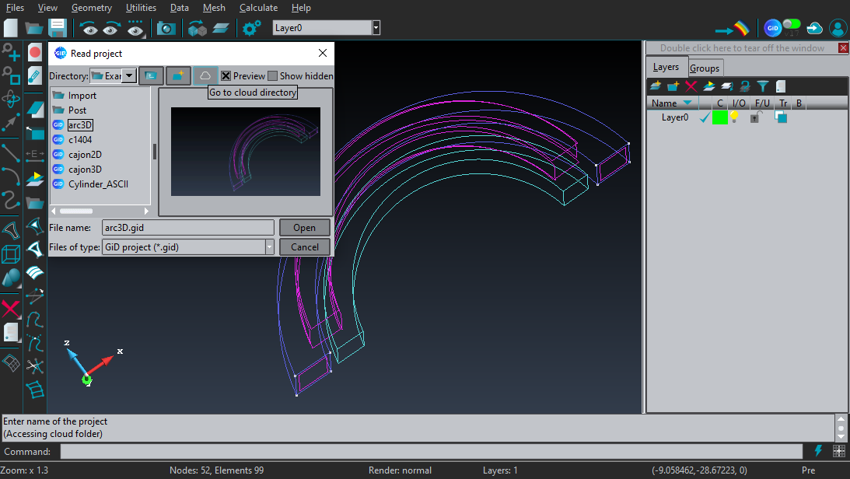
GiD Model Manager
Store models in the cloud and share them
Notes:
GiD Local → guardar modelos en la nube
Web → model manager → compartir

Slide 16
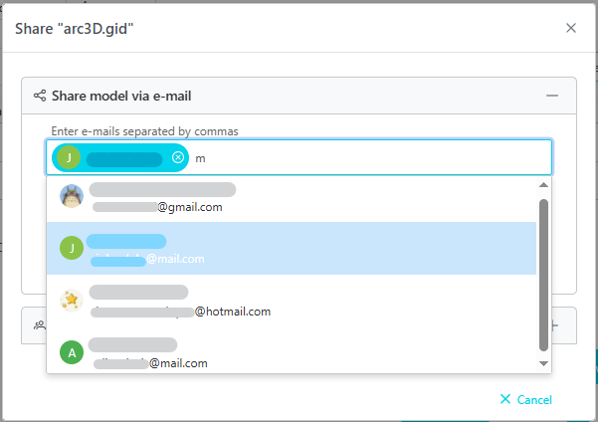
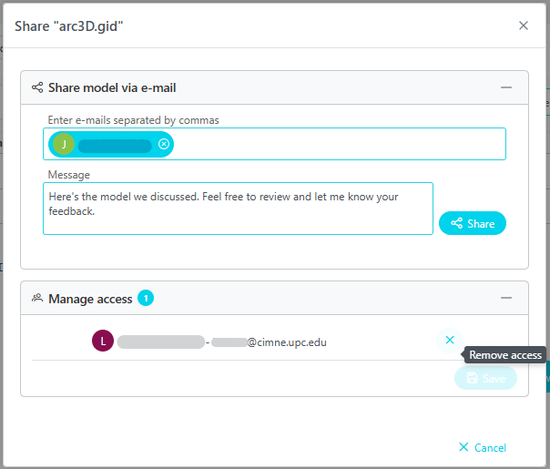
GiD Model Manager
Sharing models is now easier
Recommended users
Message and access management
Notes:
Ventana mejorada → dos secciones
Compartir (recomendados, mensaje)
Gestión de acceso (quitar acceso)

Slide 17
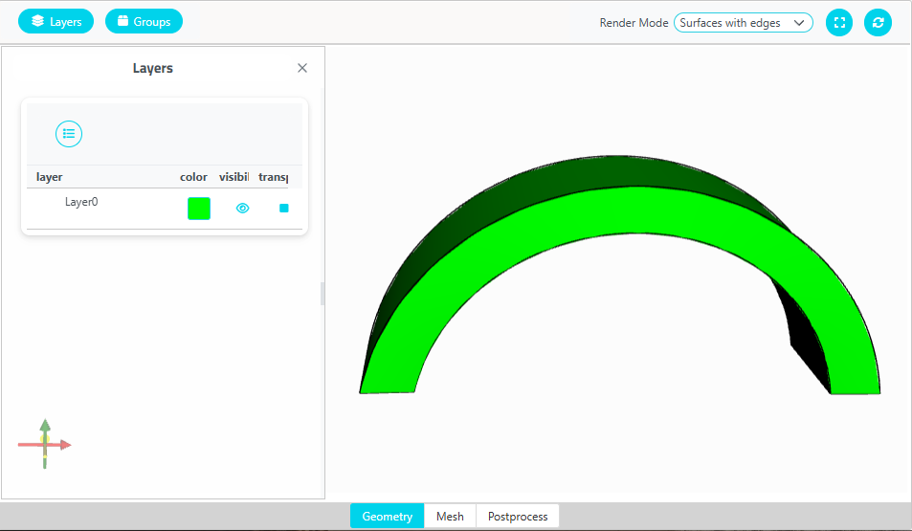
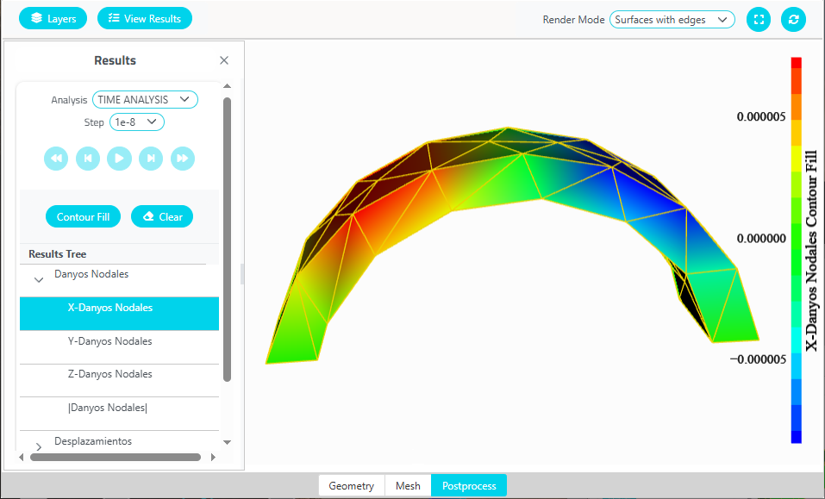
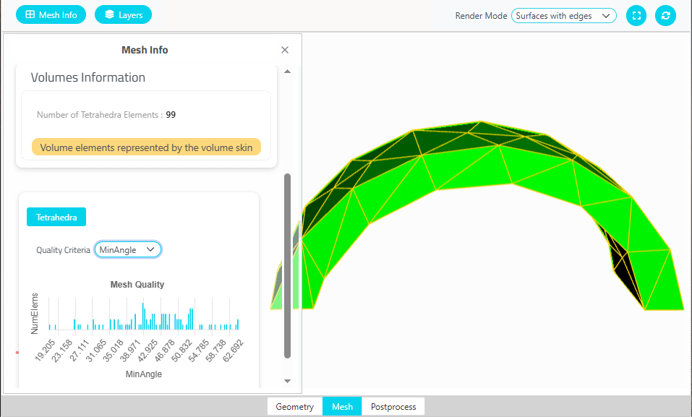
GiD Model Manager
Visualization of models
Mesh
Geometry
Post
Notes:
Visualizar modelos en tres módulos
módulo de geometría (capas, grupos)
módulo de malla ( información de la malla )
postproceso (contour fill)

Slide 18

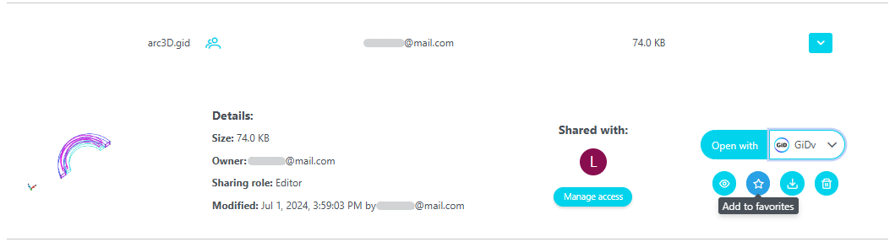
GiD Model Manager
Favorites list
Notes:
pantalla de inicio → Nuevo espacio
mis modelos
compartidos
favoritos
añadir a favoritos → detalles del modelo → botón de añadir / quitar

Slide 19
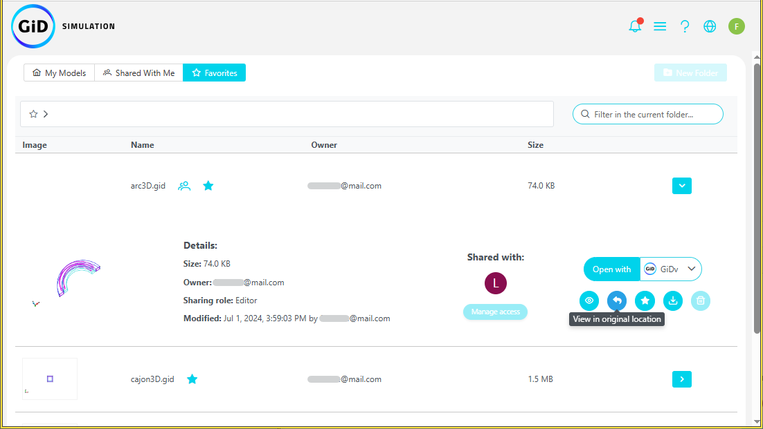
GiD Model Manager
Notes:
Espacio de favoritos → lista de modelos
Acciones de modelo → ver en ubicación original

Slide 20
GiD Model Manager
From GiD Local to Web
Notes:
mejorar la conexión GiD Local ←→ GiD Web
abrir modelos del uno al otro.

Slide 21
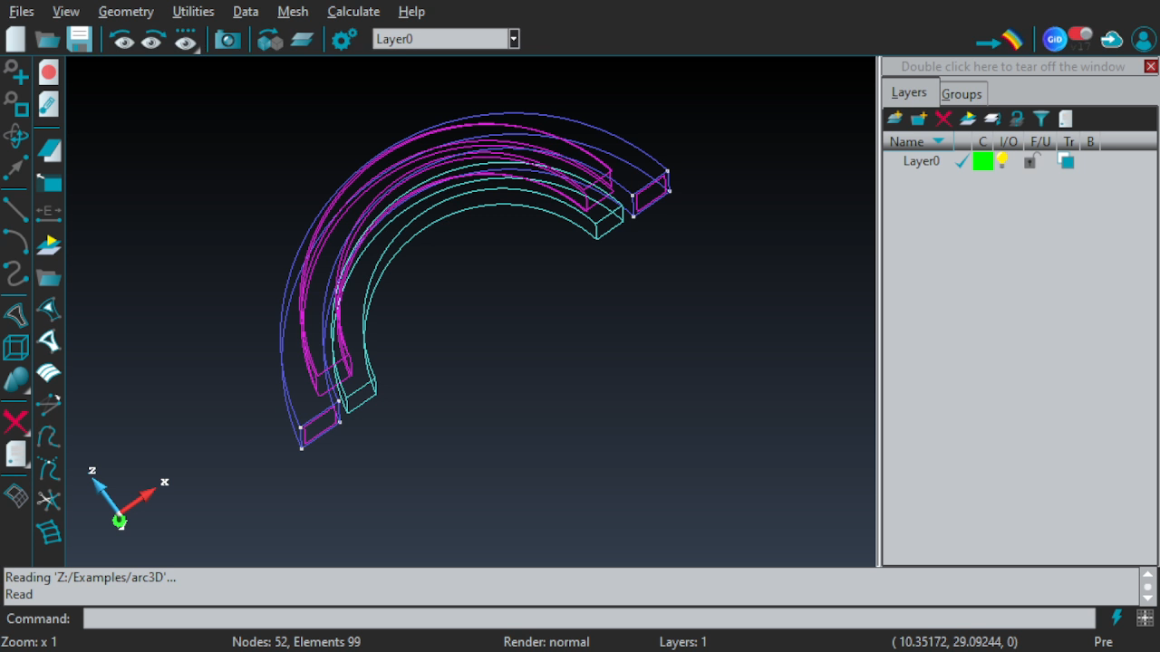

Slide 22
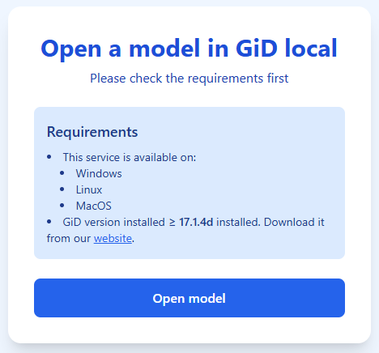

GiD Model Manager
From GiD Local to Web
From Web to GiD Local
Notes:
mejorar la conexión GiD Local ←→ GiD Web
abrir modelos del uno al otro.

Slide 23
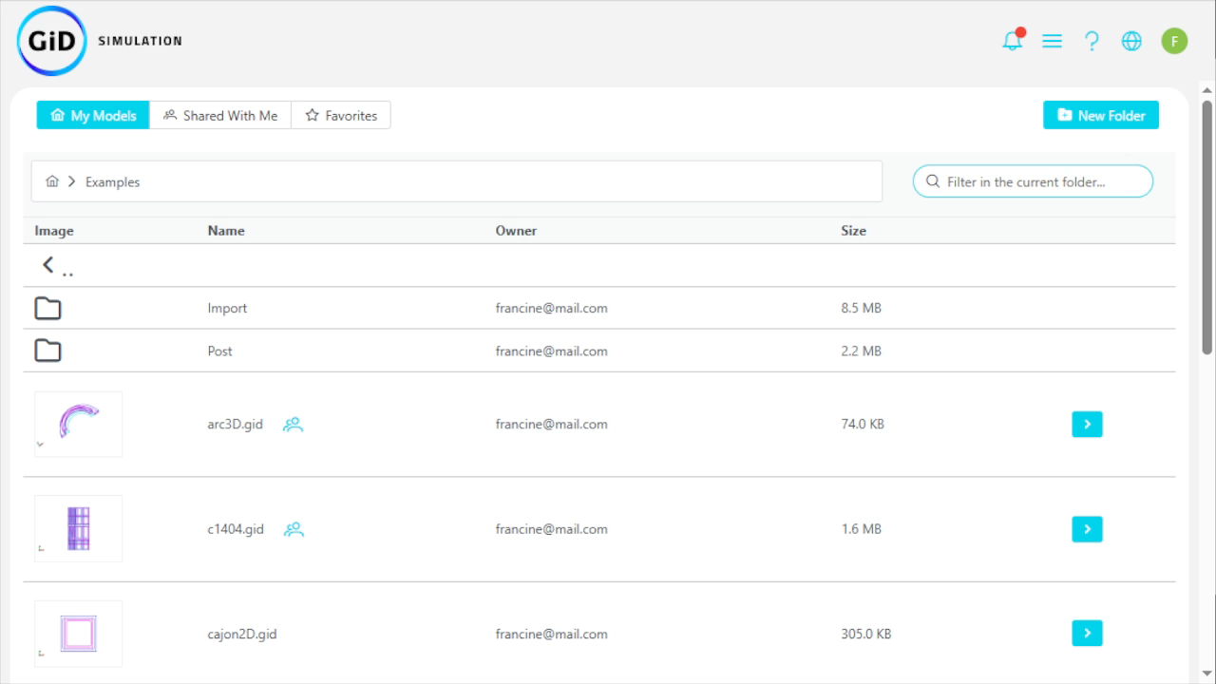
GiD Model Manager

Slide 24
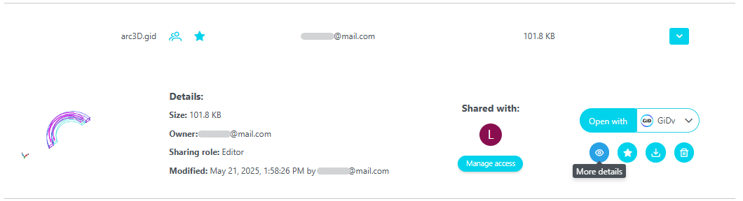
GiD Model Manager
Gallery
Notes:
galería de un modelo
screenshots
clips

Slide 25
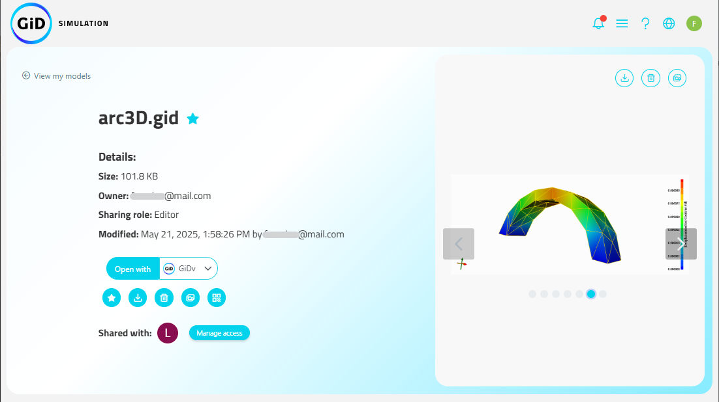
GiD Model Manager
Notes:
vista previa

Slide 26
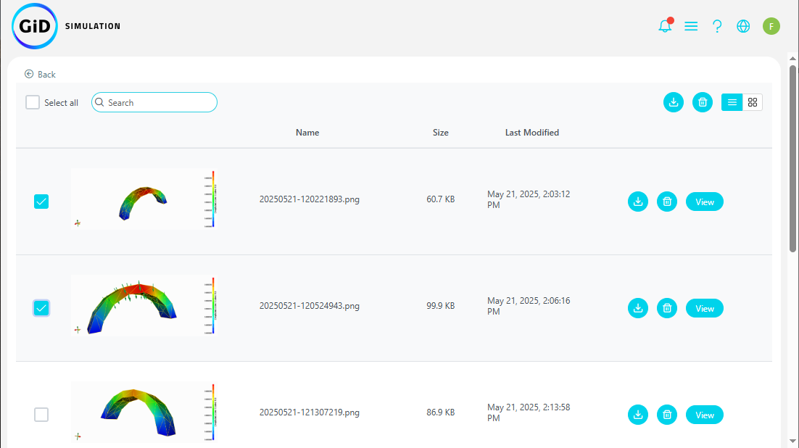
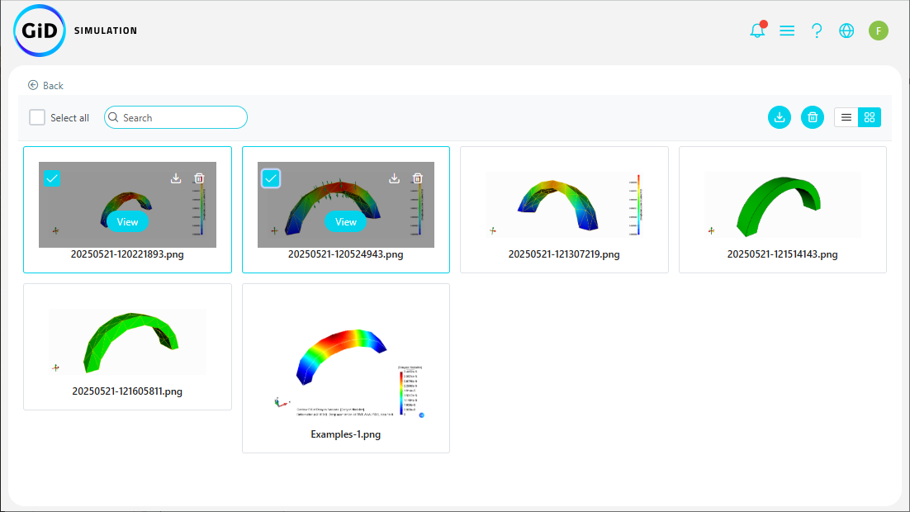
GiD Model Manager
Grid view
List view
Notes:
Vista genérica de todas las imágenes y videos.
Gestionar:
borrar
descargar
buscar
Seleccionar varias y aplicar las acciones a todas a la vez.
Ver en pantalla completa.

Slide 27
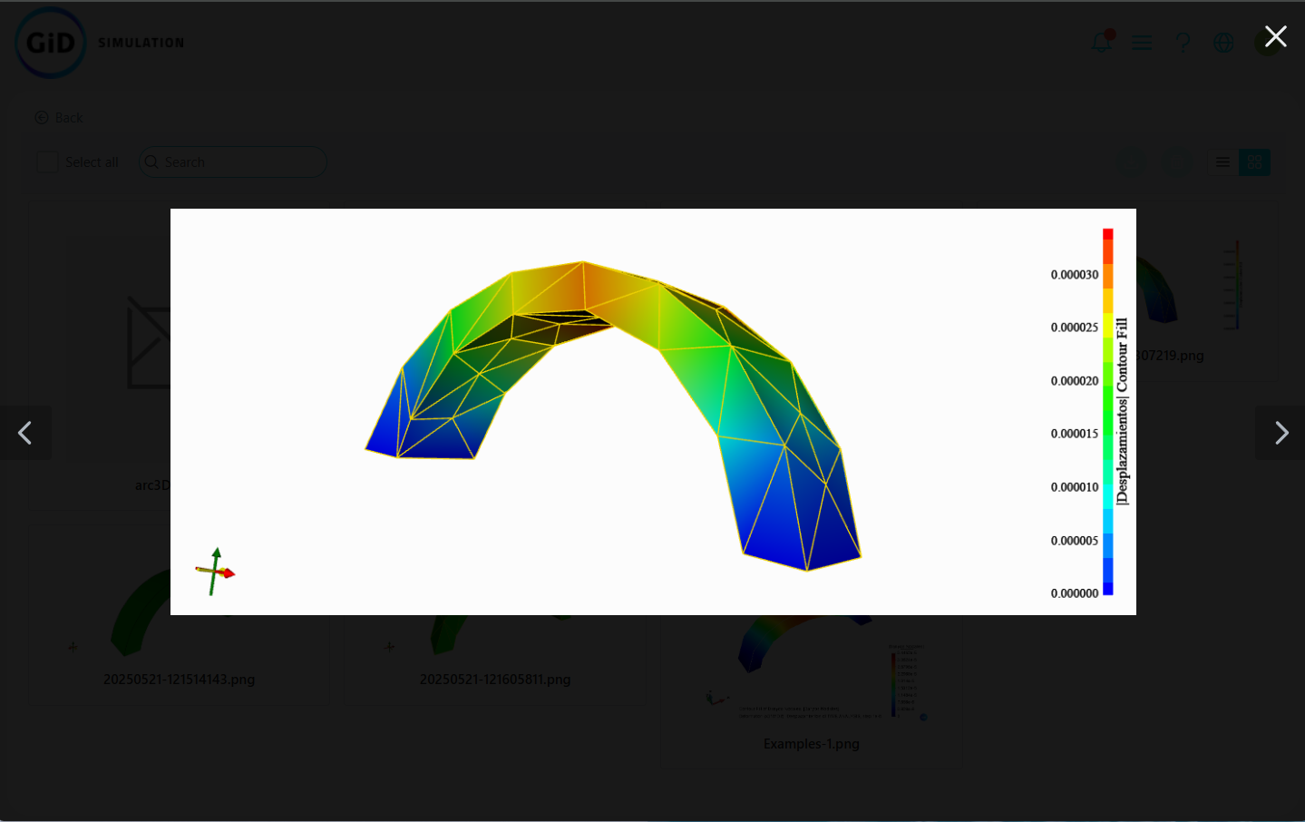
GiD Model Manager

Slide 28

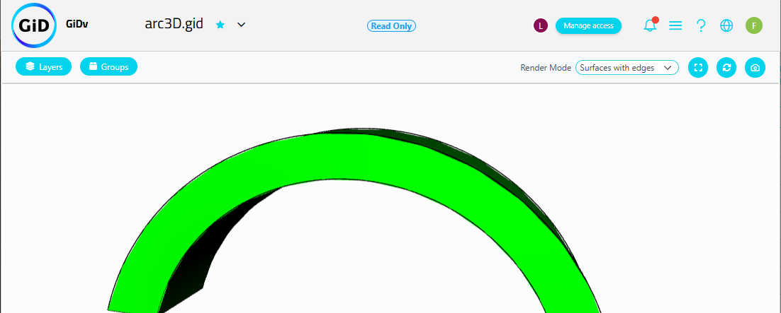
GiD Model Manager
Add screenshots
  GiD Web - GiDv
Notes:
Entrar al modelo → GiDv → botón tomar captura.

Slide 29
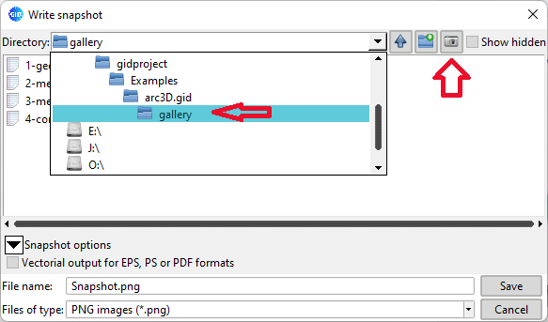
GiD Model Manager
Add screenshots and clips
  GiD Local - “gallery” folder
Notes:
Added option in Snapshot/animation save file dialog to save files in project.gid/gallery/ folder which is accessible from the Model Manager as Gallery.

Slide 30
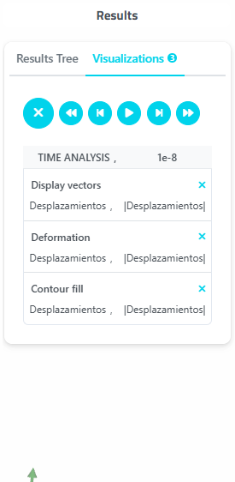
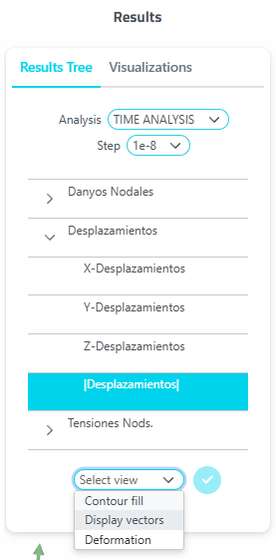


GiD Model Manager
More post-processing features
  Deformation
  Vectors
Notes:
módulo de postproceso → ventana de visualizar resultados.
permite visualizar:
deformada
vectores

Slide 31
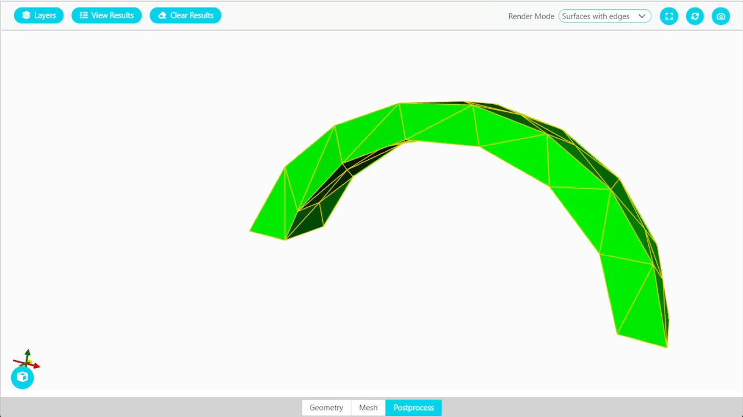
GiD Model Manager
Deformation

Slide 32
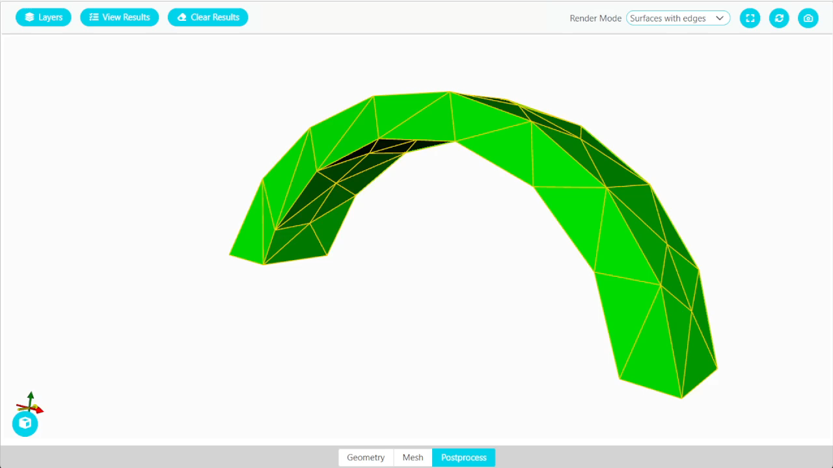
GiD Model Manager
Vectors

Slide 33
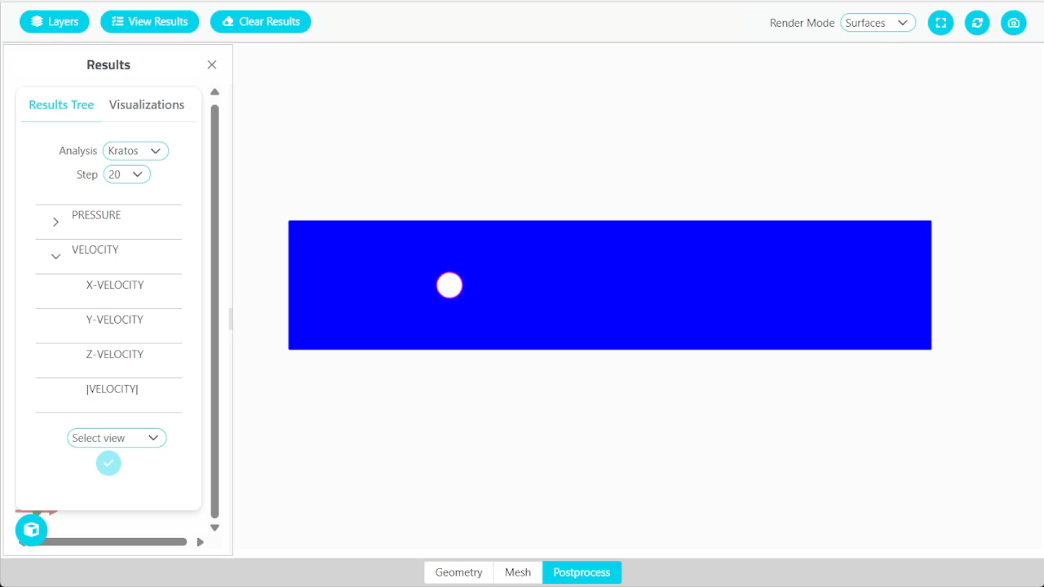
GiD Model Manager

Slide 34
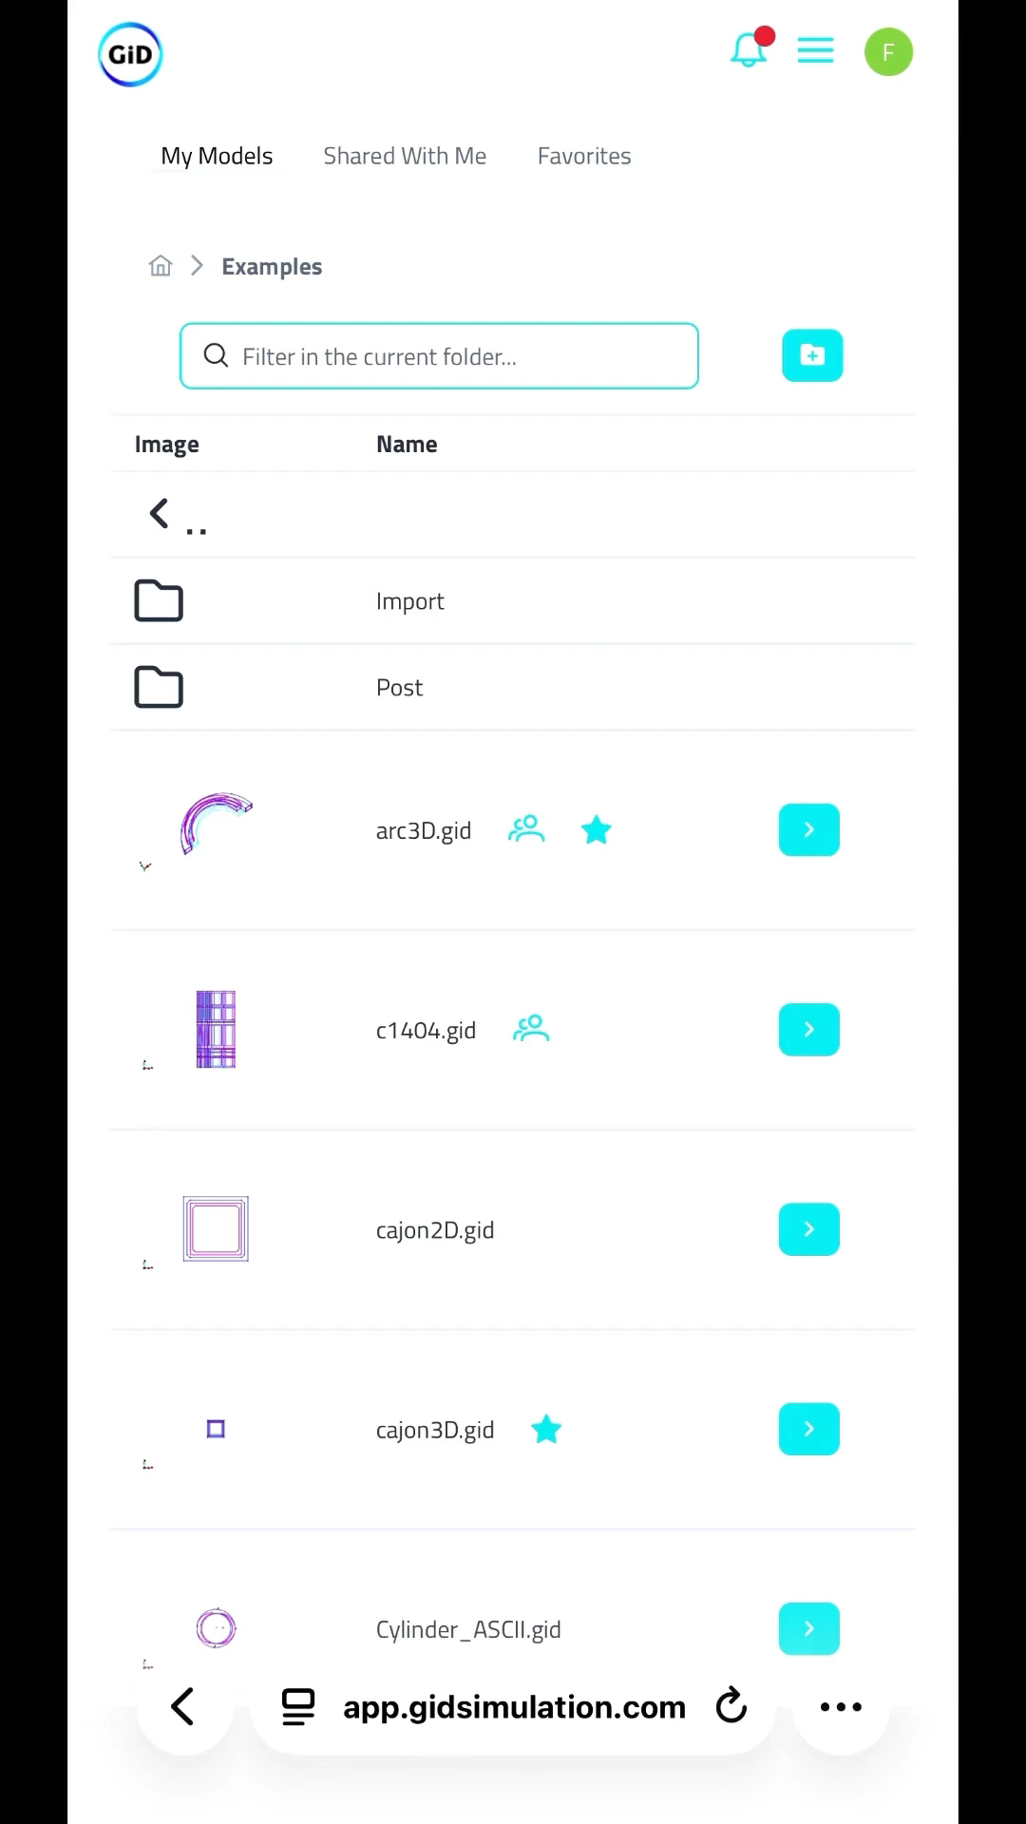
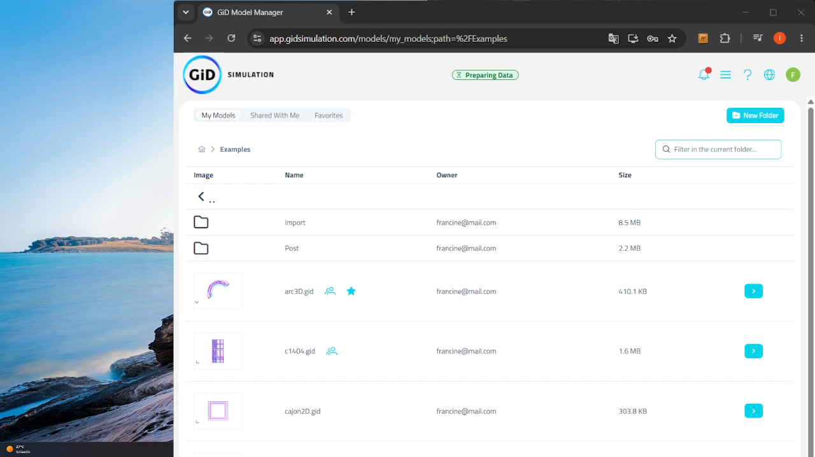
GiD Model Manager
Offline access
  Download the application.
Notes:
Acceso sin conexión por modelo
Acceso directo de la web como si fuera una aplicación:
escritorio (windows, pero en móviles android, xaomi, samsung, …. es igual )
tablets y móviles. ( iphone, pero en todos los dispositivos iOS es igual )
IMPORTANTE : La primera vez se tiene que entrar con conexión para que cargue todo.

Slide 35
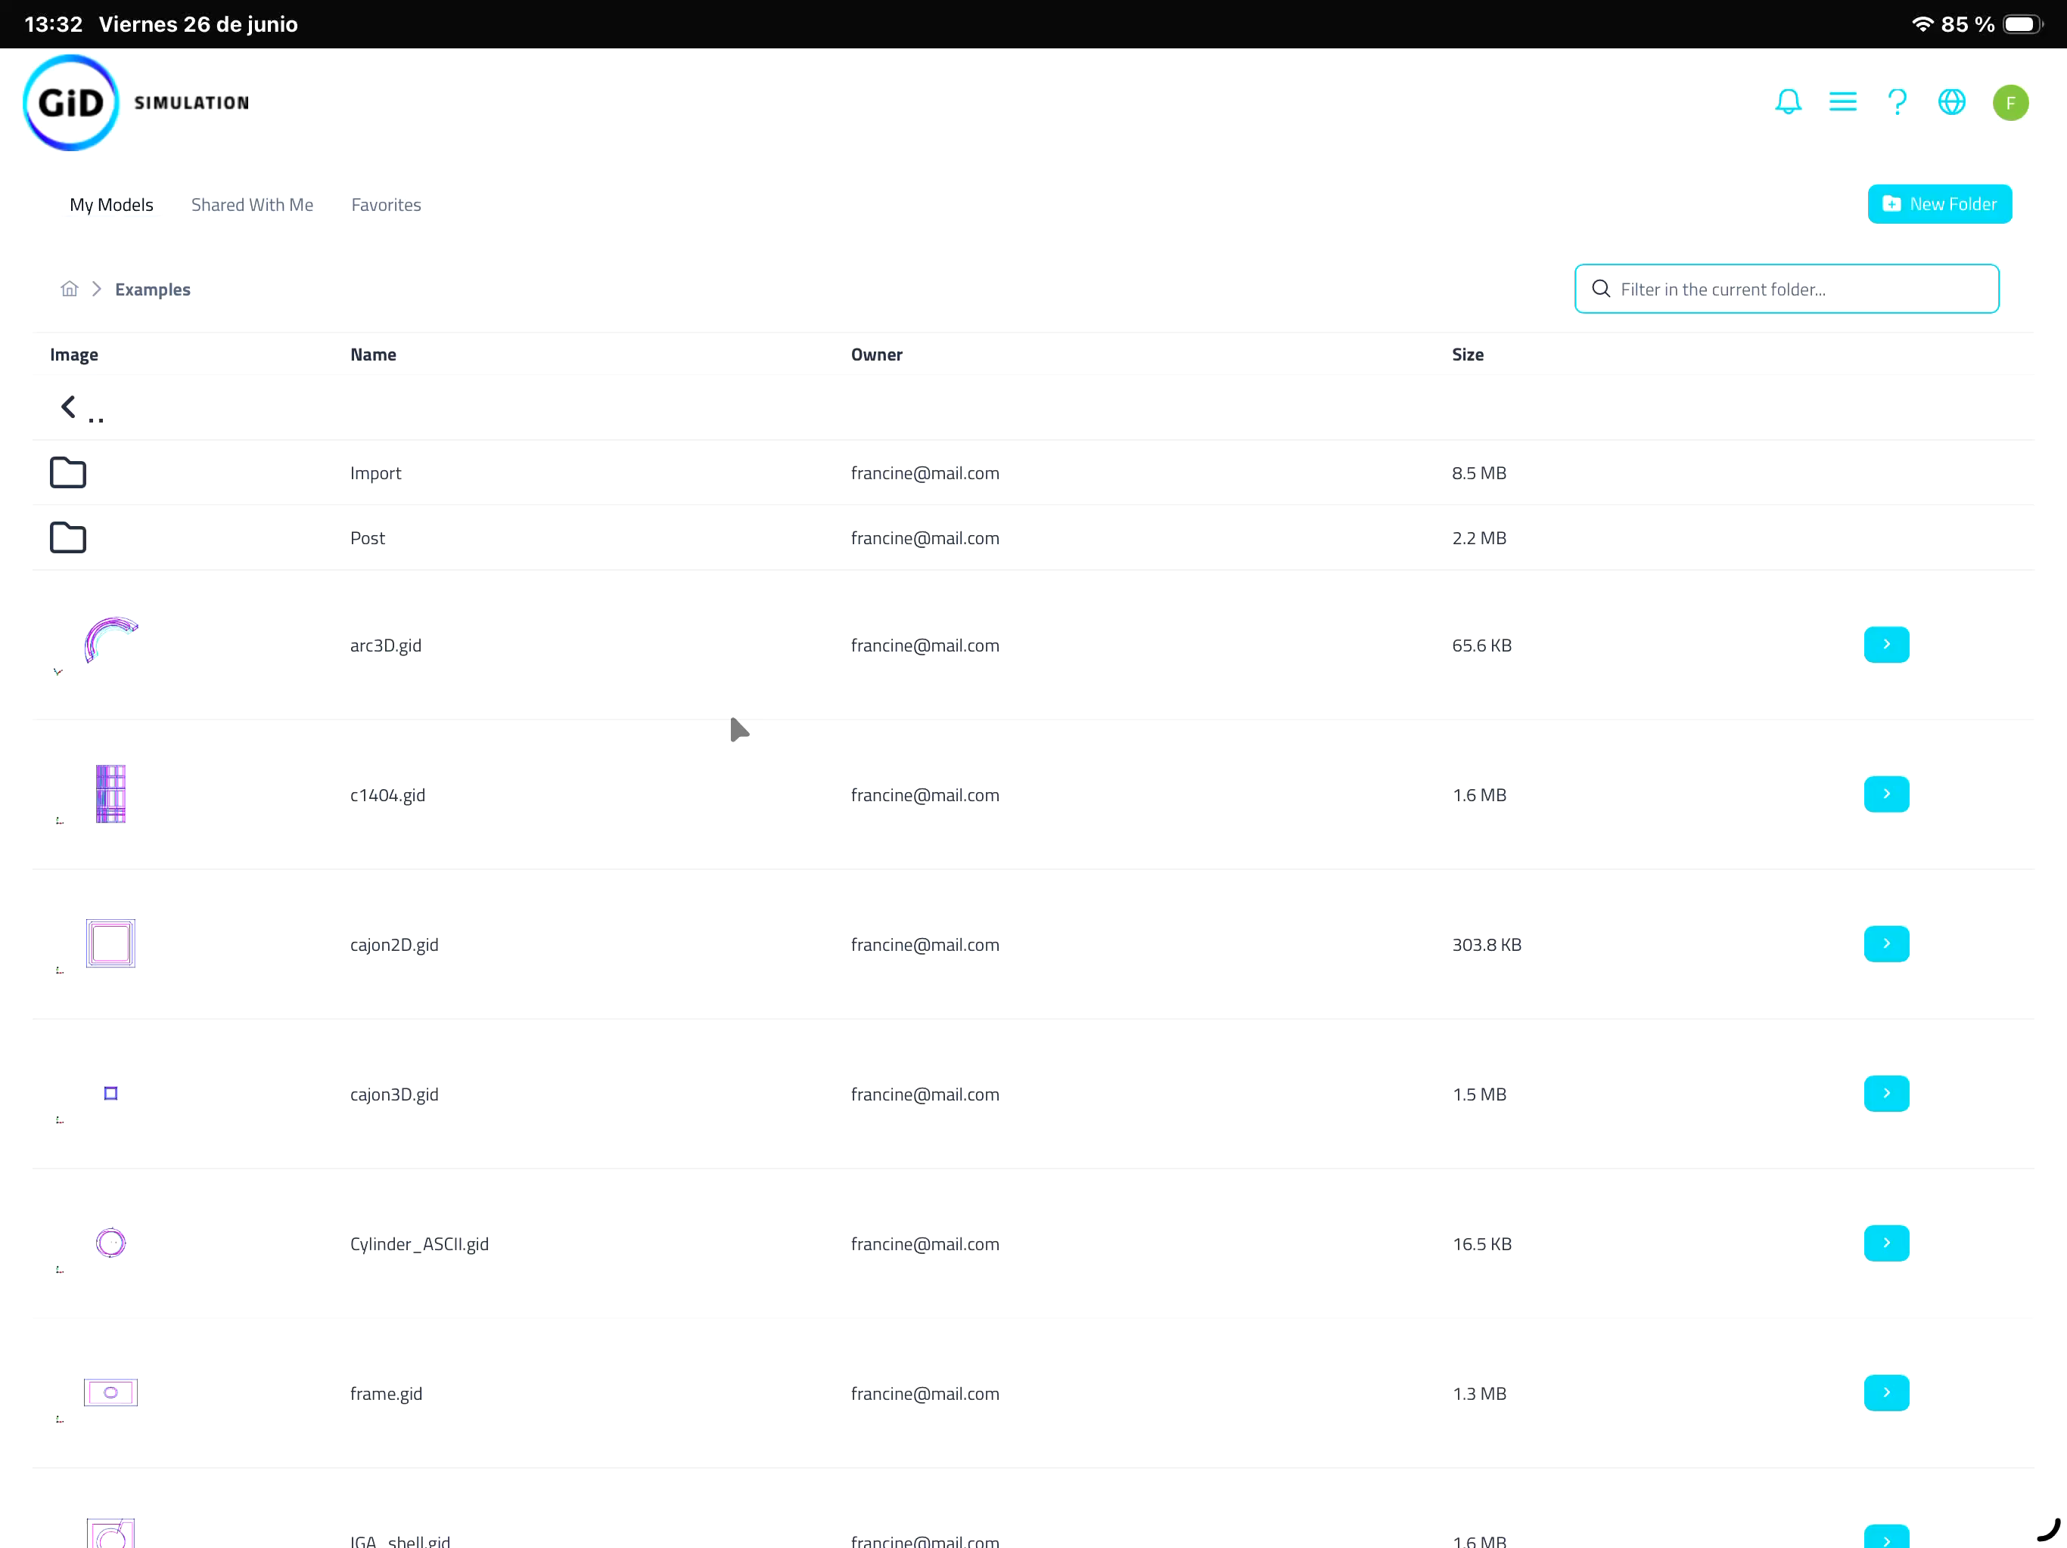

GiD Model Manager
Offline access & View models offline
Notes:
Acceso sin conexión por modelo
Visualiza los modelos sin conexión:
Primero hay que activar el acceso sin conexión
Solo podrás visualizar los modelos sin conexión si los has activado antes.

Slide 36


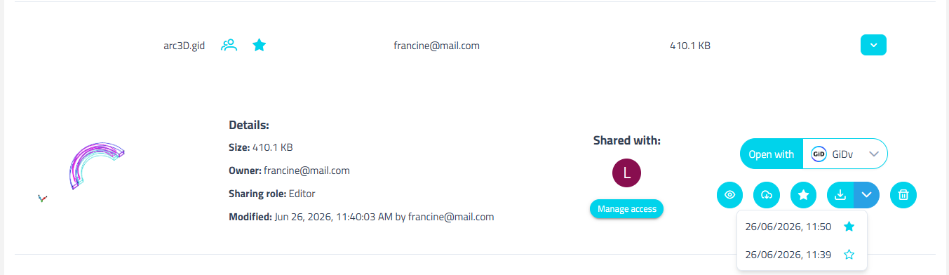
GiD Model Manager
Download versions of a model
Notes:
El botón de descarga ahora está dividido en dos partes:
Izquierda : descarga la última versión del modelo
Derecha : muestra el listado de versiones para descargar.
Ahora se pueden descargar versiones antiguas de un modelo.
Al guardar un modelo se genera un zip de esa versión que puedes descargar.
Las versiones más antiguas se borran al mes, a no ser que la marques con el icono de la estrella que entonces la preservará.

Slide 37

Future lines
Create work teams / classes
  Share models
  Manage licences
Public models
Chat in models
More post-processing options
Increase size limits for GiDv
Calculation module
  Launch calculations in the cloud
  Real-time result visualization from the web

Slide 38
Thank You !
GiD Development Team:
Miguel Pasenau, Enrique Escolano, Abel Coll, Adrià Melendo, Javi Gárate, Laura Santos
July 1st 2026

